Slide 1
Susan Lessick, MA, MLS, AHIP, FMLA
Project Director, MLA Research Training Institute
Librarian Emerita, University of California, Irvine
MLA’18, May 21, 2018, Atlanta
Notes:
Good afternoon! I’m Susan Lessick, Librarian Emerita from the University of California, Irvine. This afternoon I am going to report on the new MLA Research Training Institute for Health Sciences Librarians (RTI).

Slide 2
Outline
Background
Why RTI is needed
Goals
Scholarship support
Our Partners
Application Process
Selection Process
Curriculum
RTI Community of Practice
Assessment
Communication Plan
Notes:
Today’s presentation provides an update on the RTI, which is a three-year project funded by the Institute of Museum and Library Services (IMLS) that seeks to provide professional development opportunities and a support system for health sciences librarians who want to improve their research skills and increase their research output.
I will cover:
background information on the project
why the project is so needed
project goals
scholarship and partnership support
Application and selection process
Curriculum
Community of Practice
Assessment plan
Communication plan
There will also be time at the end of the presentation for questions and comments.

Slide 3
Background
MLA’s long history of advancing research in the profession dates back to 1980s.
Highly influential research policy statements
Pioneering education policies with strong emphasis on research competencies
Many other research-related programs over years
In 2015, Board established a 3-year goal to advance health information research and evidence-based practice.
Appointed Research Imperative Task Force (RITF), 2015-2018.
Developed plan to establish an MLA Research Training Institute.
Unanimously endorsed by the Board, May 2016.
RITF submitted an IMLS grant proposal to fund the development of the RTI which was approved, April 2017 ($238,989).
Notes:
Let me start by sharing that MLA has long recognized the importance and benefits of research in practice through research policies, educational standards, the awards programs, our peer-reviewed journal (JMLA), and other research focused initiatives.
In 1995, MLA adopted the highly influential research platform, Using Scientific Evidence to Improve Information Practice, as a call to action for health sciences librarians to become “creators, managers, and active users of scientific evidence.”
In 2007, the association revised the statement which is still in effect, reaffirming its commitment to the importance of research in practice. The new statement challenges MLA to create a research culture where “analysis and application of a health information research knowledgebase” is commonplace, so that health information practitioners, just like their health care practitioners colleagues, use the best available evidence when making decisions pertinent to libraries. And let me suggest there are other good reasons for health sciences librarians to conduct research, such as demonstrating library impact, partnership opportunities, advancing the profession, etc. But that’s another paper…
Then in May 2015, the Board established a 3-year goal to support and advance health information research and evidence-based practice throughout the profession.
To achieve this goal, it appointed Research Imperative Task Force (RITF) that developed and implemented 10 “actionable” strategies and objectives during 2015-2018.
Central to the Task Force action plan was the development of a plan to establish an MLA Research Training Institute.
The RTI plan was unanimously endorsed by the MLA Board of Directors, May 2016.
Our Task Force then submitted an IMLS grant proposal to fund the development of the RTI, which was approved; MLA was awarded a 3-year Laura Bush 21st Century Library Grant ($238,989) that will run from July 2017 – June 2020.
We are currently in the 1st year of implementation of the RTI.

Slide 4
Why is RTI needed – benefits
Benefits of research in health science librarianship
Librarian-led research shows:
Link between role of HS librarians in EBP processes and improved health outcomes (Sollenberger, 2013; Marshall, 2014).
Other high quality studies show positive impact of librarians’ involvement in health care.
Evidence You Can Use to Communicate Library Value
http://www.mlanet.org/p/cm/ld/fid=1361
Survey of HS librarians shows:
HS librarians conduct research primarily to demonstrate library value and get guidance in practice.
Most HS librarians who have conducted research reported it resulted in improving or initiating new services. (Lessick S, et al, 2016)
Notes:
Health sciences librarians benefit from using, creating, and applying research-based evidence in library practice and in supporting quality health care. Health sciences librarians have played a key role in initiating, nurturing, and spreading evidence-based practice (EBP) in the health professions (Marshall, 2014), and librarian-led research has shown a link between the role of health sciences librarians in EBP processes and improved health outcomes (Sollenberger, 2013; Marshall, 2014).
Inspired by EBP developments in the health professions and MLA’s heightened focus on advancing research in the profession, there has been a marked increase in attention to evidence-based practice in health sciences librarianship (Funk, 2013) and in the number of published research studies produced by health sciences librarians over the last twenty years (Plutchak, 2005; Gore, 2009). In a 2016 survey of the research-related activities and attitudes of HS librarians, both academic and hospital librarians ranked demonstration of the value of libraries and provision of guidance as primary motivating factors for conducting research. Almost two-thirds of those who were able to engage in research reported that their research had resulted in improving or initiating new health library services (Lessick, 2016).

Slide 5
Why is RTI needed – strengthen research base
Need to strengthen research base in HS librarianship
Too few HS librarians conduct high quality research
Too few HS librarians disseminate the results of their research
Challenges
Insufficient research in many vital areas (Plutchak, 2005)
Quantity and quality of research varies for different subject areas (Plutchak, 2005)
Quality of surveys are uneven (Starr, 2012)
Level of complexity is insufficient (Koufogianakis, 2006; Cooper 2016)
Over-emphasis on applied studies & descriptive techniques (Gore, 2009)
Lack of replicating studies and verification of existing research results (Plutchak, 2005; Koufogiannakis, 2006)
Notes:
Despite the benefits of research and the increase in research activities by health sciences librarians, too few health sciences librarians conduct high quality research linked to practice and disseminate the results of their research. Journal editors and scholars have noted various issues with published health sciences librarian research, which is limiting the development of a research base in health sciences librarianship: dearth of research and evidence in many vital areas of library practice (Plutchak, 2005; Koufogiannakis, 2006); quantity and quality of research varies for different subject areas (Plutchak, 2005; Koufogiannakis, 2006); quality of surveys are uneven, e.g., surveys frequently relate exclusively to local problems, have sample bias, and use ambiguous survey questions (Starr, 2012); level of complexity of research is insufficient (Koufogiannakis, 2006; Cooper 2016); over-emphasis on applied studies and descriptive techniques (Gore, 2009); and pervasive lack of replicating studies and verification of existing research results (Plutchak, 2005; Koufogiannakis, 2006).
Strengthening our research base with additional quality research that is directly relevant to the decision-making needs of practitioners and builds upon previous foundations, is essential in moving our profession forward.

Slide 6
Why is RTI needed – obstacles
Obstacles to conducting research
Barriers to academic librarian research (Kennedy, 2012)
Lack of time
Unfamiliarity with research process
Lack of support for research activities
Lack of confidence
Inadequate education in research methods
HS librarian struggle with same barriers
Top ranked barriers: lack of time to do research at work, training, and support
Most would like opportunities to conduct research with others and participate in extra training (Lessick et al, 2016)
RTI aspires to fill these knowledge and support gaps by providing:
intensive training in research methods
opportunities to work with experienced researchers
personalized assistance from experts to complete projects
encouragement, peer support, and participation in a Community of Practice
resources for HS librarians unfamiliar with and hesitant about the research process
Notes:
Health sciences librarians face numerous obstacles to conducting research. Barriers to academic librarian research have been widely reported in the library literature. These include lack of time to complete a research project, unfamiliarity with the research process, lack of support for research (both social and monetary), lack of confidence, discouraging jargon, inadequate education in research methods, lack of motivation, and uneven training in research design at the Master’s level (Kennedy, 2012).
Health sciences librarians struggle with many of the same barriers, but most often cite lack of time allotted for research activities at work, lack of training, and lack of institutional support – with hospital librarians consistently reporting the greatest difficulties conducting research (Lessick, 2016). However, at the same time, large majorities of both academic and hospital health sciences librarians report they would welcome opportunities to do research with other experienced researchers and participate in extra training to acquire research skills (Lessick, 2016).
Our intent is for the RTI to fill these knowledge, skills, confidence, and support gaps by providing:
intensive training in research methods
opportunities to work with peers & other experienced researchers
personalized assistance as participants complete their projects
Encouragement [to persevere] – very important!
an online support network
and resources for librarians unfamiliar with and hesitant about the research process.

Slide 7
Goals
Goal: Build research competencies of HS librarians & increase quantity, quality, and communication of HS librarian-led research.
Objectives:
5-day intensive workshop on research design at UIC in 2018 and 2019
Cohort of 20 participants per year
Requirement to complete research project within 12 months
Produce high quality health information research studies
Augment instruction with ongoing mentoring
Build & sustain a strong Community of Practice
In 3rd year of grant, develop a plan to offer RTI online program
Assess the effectiveness of all aspects of the Institute
Provide scholarships for RTI participants
Notes:
The broad goal for the project is to build research competencies of HS librarians & increase quantity, quality, and communication of librarian-led research.
Specific objectives for the project include:
Offer a 5-day intensive workshop on research design at UIC in 2018 and 2019 – this is the centerpiece of the RTI program.
Provide research curriculum and support for cohort of 20 participants per year
Increase research outputs of HS librarians by requiring participants to complete research projects within 12 months – potentially this will add 40 new health information research studies by end of grant
Increase the quality of health information research studies through the development and use of a rubric that measures the quality of a research study
Augment instruction with ongoing mentoring
Build & sustain a strong Community of Practice that maximizes participants’ learning, productivity, and collaboration…and increases research confidence of participants.
In 3rd year of grant, develop a plan to offer an RTI online program, extending RTI training, outreach, and penetration to the wider librarian community.
Provide scholarships for RTI participants
Assess the effectiveness of all aspects of the Institute – more about this later

Slide 8
Scholarship support
From grant & partners
From Sections & Chapters
Grant funds 2 full scholarships for librarians from small libraries & 6 other partial scholarship per Institute
AAHSL scholarships (2 full scholarships per Institute)
Augment scholarships with Section & Chapter donations
2018: 11 Sections & 3 Chapters; 5 full scholarships & 14 partial scholarships
Sections:
Cancer Librarians Section
Collection Development Section
Consumer and Patient Health Information Section
Educational Media and Technologies Section
Medical Informatics Section
Nursing and Allied Health Resources Section
Pharmacy and Drug Information Section
Public Health/Health Administration Section
Public Services Section
Technical Services Section
Veterinary Medical Libraries Section
Chapters:
Mid-continental Chapter (MCMLA)
Philadelphia Regional Chapter
Upstate New York and Ontario Chapter (UNYOC)
Notes:
The IMLS grant funds two all-inclusive scholarships per Institute to increase accessibility to Institute training for library professionals working in small libraries with limited budgets. Increasing the research engagement of this group, which includes many hospital librarians, is a critical professional issue. Health sciences librarians from small libraries face challenging budget circumstances and need additional support for research training and to conduct research. Hopefully our training program and community of practice will help these isolated librarians build lifelong relationships with other colleagues with similar research interests.
The grant also funds 6 partial scholarships (specifically for registration fees) for other librarians who need financial assistance to attend the Institute.
IMLS scholarship funds have been augmented with funds from the Association of Academic Health Sciences Libraries (AAHSL), a long-established MLA partner, which agreed during to the grant submission process, to fund 2 more all-inclusive scholarships per Institute for professionals working in AAHSL libraries.
This year we also encouraged MLA Sections and Chapters to donate funding for RTI scholarships. We believe that this project has broad interest since much more support for librarian-led research is needed throughout the association/Sections/Chapters. Even though our fundraising letter went out a bit late in the process, the fundraising effort was very successful. The combined donations from Sections/Chapters enabled us to give either full or partial scholarships to every participant who indicated a financial need on their application form – we were able to fund 19 scholarships!
We are deeply appreciative for these donations and thank AAHSL and all these MLA sections and chapters listed on the slide for their exemplary, far-sighted, and generous support of the 2018 RTI Fellows!

Slide 9
Our partners
RTI partnerships were forged with 4 other organizations:
University of Illinois at Chicago, Library of the Health Sciences-Chicago, hosts the summer Institute in Chicago at no charge.
Association of Academic Health Sciences Libraries (AAHSL) provides 2 full scholarships per year for RTI Fellows from AAHSL Libraries.
Research Institute for Public Libraries (RIPL), Library Research Service at the Colorado State Library, will fully collaborate with the RTI program by sharing program information and materials.
SAGE Publishing provides free eTextbook for RTI Fellows and instructors, Creswell, J. W. (2018). Research Design: Qualitative, Quantitative, and Mixed Methods Approaches (5th ed.). Washington, DC: Sage.
Notes:
During the grant process we were also able to establish partnerships with other organizations that share our vision for the RTI -- our shared vision is that the RTI will be a “cornerstone in helping the next generation of health sciences librarians change from informed consumers of research, to producers of quality research.” We thank our RTI partners for their generous support and in helping us realize that dream for the future!

Slide 10
Application process
Developed by RITF and small planning team
Application materials:
Online application form
Statement on learning goals
Research proposal
CV
Letter of support
Applications open, Nov 15-Dec 8, 2017
Applications reviewed by the RTI Jury, Dec 9 , 2017– Feb 14, 2018
Applicants notified, April 15, 2018
Role of RTI Project Director
More info: http://www.mlanet.org/p/cm/ld/fid=1334
Notes:
The application process for the RTI was developed by the RITF with assistance from a small planning team. We hope this process is easy to understand for MLA members, provides helpful aids for people who may be considering submitting an application to the program, and provides sufficient information for the RTI Jury to use in evaluating applications.
Applicants submit an online application to apply. They also submit a brief statement on learning goals (“Explain why you are applying and what you are hoping to gain from participation in the Institute”; a research proposal; their CV; and a letter of support from director/dean/administrator.
This year the application process was open Nov 15 – Dec 8, 2017. Applications were reviewed by the RTI Jury in Dec and Feb. Notifications were sent to the applicants in mid April.
Role of RTI Project Director. As Project Director, my role is to assist potential applicants with this process. Because I do not participate in the jury review and selection process – I am very happy to provide information and answer questions from potential applicants. I see my role as a resource for anyone needing help, tips & guidance with their applications, research topic ideas, and proposals. So potential applicants of the RTI should feel free to contact me.
I also want to point out that there is lots of information and tips about the process on the RTI website, so, I would also encourage you to visit the RTI website.

Slide 11
Selection process
RTI Jury reviews applications and makes decisions
Review process uses a strict research-based protocol
Some application items are blinded
Rubrics used to assist decision-making
Special rubric used that measures the quality of a research proposal – also used to assess the Fellow’s completed research study at the end of the program.
Applications are reviewed, scored, and ranked by two different RTI Jury members
42 applications, 20 selected
5 full scholarships & 14 partial scholarships awarded
Notes:
The RTI Jury reviews all applications and makes decisions on admissions to the program and scholarships for the applicants.
The review process for applications uses a strict research-based protocol In evaluating, scoring, and ranking applications. This ensures an unbiased evaluation of each application. Certain items in the application are blinded (learning goals statement & proposal) during the review. Rubrics for each component are used to assist decision-making. One of the rubrics measures the quality of the research proposal submitted. This rubric will also be used to assess the quality of the Fellows’ completed research study at the end of the program to measure the Fellows’ progress.
This year we had 42 applications and the RTI Jury selected 20 applicants for participation in the 2018 RTI program. We were also able to provide scholarships for every selected applicant who indicated a need for financial support – we feel very good about that. I would like to recognize the Fellows in the audience who will be attending the first-ever RTI program in Chicago this summer. Can any new RTI Fellows is the audience, please stand so you can be recognized!

Slide 12
Curriculum
One-year learning program for participants
Pre-Institute online learning activities, May-June, 2018
Intensive on-site training session, July 9-13, 2018
eTextbook
Creswell JW, Creswell JD. Research Design: Qualitative, Quantitative and Mixed Methods Approaches. 5th Ed. Sage, 2017.
Augmented by mentoring for one year, July 2018-June 2019
Augmented by participation in Community of Practice
5-member teaching faculty
http://www.mlanet.org/p/cm/ld/fid=1340
Notes:
RTI training program is one year in length.
The program is comprised of pre-Institute online learning activities and a one-week intensive workshop on research design. The program provides mentoring support for one year following the workshop to help each Fellow conduct their research project and prepare their results for dissemination.
The workshop is comprised of lectures, large and small group activities, and one-on-one consultation with mentors. Training covers the research process; research ethics and IRBs; research funding; formulating a relevant research question; literature reviews; research methods and design; data management and analysis; surveys, interviews & focus groups; disseminating findings; writing a research article; research impact; and much more.
We are very fortunate to have 5 stellar faculty available throughout the year-long training program. 2 instructors will be available onsite for the week of the workshop – this is supplemented by 3 other instructors who provide teaching support at the workshop, Tuesday through Thursday. The Fellows and faculty also take part in the RTI Community of Practice, along with 3 researcher-consultants and the RTI staff, to facilitate learning, knowledge exchange and relationship building.

Slide 13
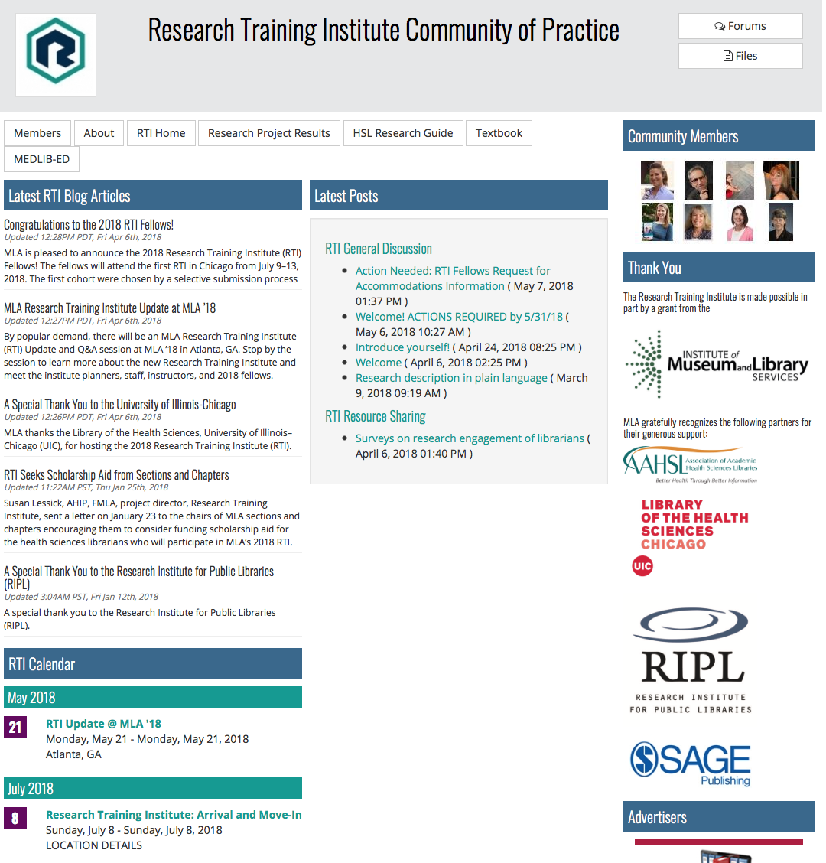
RTI Community of Practice
Uses MLANET community forum feature
Community page serves as a central hub of information about RTI
General Discussion Forum is a safe online forum for sharing information & getting help
Notes:
The COP is a central hub for RTI Fellows, instructors, consultants, and MLA staff. Participants are able to access all RTI information, resources and files, MEDLIB-ED, calendar and future events, and very importantly, to share information and get assistance in the RTI General Discussion Forum.
The COP is a safe online forum where Fellows can collaborate with other Fellows on their research projects and get encouragement and assistance from instructors and other experienced researcher-consultants as they conduct their research projects.

Slide 14
Assessment
Learning outcomes and librarian research confidence.
Research project completion
Quality of research project
Subsequent research engagement of participants
Teaching and mentoring effectiveness
Overall program effectiveness, including the application process and community of practice
Notes:
The RTI project staff will collect and assess extensive evidence of the effectiveness of all aspects of the Institute model.
Pre-Institute data provided by participants will identify initial levels of research competence and confidence, which will serve as a comparative baseline with a post-assessment survey - this will measure improvements that occurred as a result of RTI training. This pre- and post-assessment of knowledge, skills and confidence is based on an existing tool, called the Librarian Research Confidence Scale, which will allow us to compare our results with those of other continuing education programs in research.
Data will be gathered from participants regarding the progress of their research projects for one year following the Institute.
Quality of research will be assessed using a rubric that measures the quality of research conducted by Institute Fellows.
Other types of evidence of student research activities will be collected via ongoing self-reports from participants and an annual survey. We will collect data on the Fellows’ dissemination of research results through presentations and papers, their participation in research collaborations and in research education, and the impact or value of research training to their home institutions.
Participant feedback will be gathered to evaluate teaching effectiveness, instructional content, and mentoring support after each Institute workshop. Instructors plan to meet at the conclusion of each Institute to discuss and assess their instructional practices, student outcomes, and lessons learned. This feedback will be used to improve training for subsequent Institutes.
At the end of Year 2, we will collect evaluative data on key aspects of the program, including the application and selection process, scholarships, the MEDLIB-ED platform, and the RTI community of practice. Results will inform planning and improvements in Year 3. We will also conduct a final evaluation at the end of Year 3 focused on the overall effectiveness of the grant project.

Slide 15
Communication plan
RTI web site – primary communication vehicle
Share info on RTI News blog
http://www.mlanet.org/p/bl/bl/blogid=128
Community of Practice
Fellows share knowledge and enthusiasm about research with colleagues at home institutions.
RTI sessions at MLA annual meetings.
RTI staff share activities, experiences, and outcomes with wider library community.
Post curriculum products, assessment tools and reports on RTI website.
Archive RTI products, tools, & reports in PubMedCentral.
Notes:
RTI website serves as the primary communication vehicle for posting Institute, course, application, scholarship, Fellows’, and assessment information.
We have also launched an official RTI News blog to disseminate news about RTI quickly.
We encourage Institute Fellows to reflect and discuss their research experience, progress and results with one another in the RTI Community of Practice.
Fellows will also be encouraged to return to their home institutions and communities & share their knowledge and enthusiasm for research and assist other peers and colleagues with their research efforts.
We will facilitate an RTI session at the MLA annual meetings for Fellows to present their research findings.
RTI staff will collect and analyze assessment data and publish the project results in presentations and the library literature. Institute successes, lessons learned, curriculum processes and products, and assessment tools and reports will be shared to inform other continuing education programs in research.
This information will be posted on the Institute website and archived in the NIH/NLM institutional repository, PubMed Central (https://www.ncbi.nlm.nih.gov/pmc/).

Slide 16
RTI contributors
Research Imperative Task Force (RITF)
Maggie Ansell, AHIP
Kevin Baliozian, MLA Executive Director
Margaret Bandy, AHIP, FMLA
Melissa De Santis, AHIP, MLA Board Liaison
Martha Earl, AHIP
Michelle Kraft, AHIP
Mary Langman, MLA Director of Information Issues & Policies
Susan Lessick, AHIP, FMLA, Chair
Mark MacEachern
Caitlin Ann Pike, AHIP
Melissa Rethelefsen, AHIP, MLA Board Liaison
Emily Vardell
MLA Board, 2015 to present
MLA Staff
Kevin Baliozian
Mary Langman,
Barry Grant
Deb Cavanaugh
Kate Corcoran
Martha Lara
Susan Talmage
Ray Naegele
Notes:
I would like to recognize the numerous contributors to the RTI project for their efforts. As you know it takes a village to accomplish great things. This was the case with the development of the RTI…and the work of the Research Imperative Task Force in general. I sincerely thank you all for the work that was accomplished these past 3 years to make the RTI have great relevance for the participants and a lasting impact of the profession in the years to come.

Slide 17
More RTI contributors
RITF RTI Planning Team (Board proposal):
Roz Dudden-Farnam, AHIP, FMLA
Sally Gore
Lori Kloda, AHIP
Denise Koufogiannakis
Susan Lessick, AHIP, FMLA, Chair
Mark MacEachern
Joanne Marshall, AHIP, FMLA
Carol Perryman
RITF Application Planning Team:
Nancy Allee, AHIP
Kris Alpi, AHIP, Chair
Elizabeth Irish, AHIP
RTI Jury:
Melissa Rethlefsen, AHIP, Chair
Jason Burton
Sandy De Groote, AHIP
Lisa Mastin
Merle Rosenzweig
Maria Lopez

Slide 18
RTI project staff
RTI Leadership Team
Susan Lessick, AHIP, FMLA, RTI Project Director, Librarian Emerita, University of California, Irvine
Mary Langman, MLA Director of Information Issues & Policy
Barry Grant, MLA Director of Education
Debra Cavanaugh, MLA Continuing Education Coordinator
RTI Consultants
Denise Koufogiannakis, AUL, John W. Scott Health Sciences Library University of Alberta–Edmonton, Canada
Joanne Gard Marshall, AHIP, FMLA, Distinguished Alumni Professor, School of Information and Library Science, University of North Carolina–Chapel Hill
Carol Perryman, Associate Professor, School of Library and Information Science, Texas Woman’s University–Denton
RTI Instructors
Lorie Kloda, AHIP, Associate University Librarian, Concordia University, Montreal, QC, Canada
Jodi L. Philbrick, AHIP, Senior Lecturer, Department of Information Science, University of North Texas–Denton
Sally Gore, Research Evaluator Analyst, Center for Clinical and Translational Science, University of Massachusetts–Worcester
Mark MacEachern, Informationist, Taubman Health Sciences Library, University of Michigan–Ann Arbor
Emily Vardell, Assistant Professor, School of Library and Information Management, Emporia State University, Emporia, KS

Slide 19
RITF Research Resources
Health Sciences Librarian Research Guide
http://www.mlanet.org/p/cm/ld/fid=1222
Evidence You Can Use
to Communicate Library Value
http://www.mlanet.org/p/cm/ld/fid=1361
Maggie Ansell, AHIP
Chair
Michelle Bass, AHIP
Tara Brigham
Ariel Deardorff
Sandy De Groote, AHIP
Karen Heskett
Ayaba Logan
Peggy Mullaly-Quijas
Shenita Peterson
JJ Pionke
Cecilia Railey, AHIP
Merle Rosenzweig
Ahlam Saleh
Deb Schneider, AHIP
Andrea Shipper
Amy Suiter
Donghua Tao
Beatriz Varman, AHIP
Emily Ginier
Terry Jankowski, AHIP, FMLA
Kate Saylor
Darrel Willoughby
Mark MacEachern, Chair
Notes:
I also want to mention 2 new invaluable research resources that were developed by RITF teams because they support the RTI training program and are also very informative for others interested in research.

Slide 20
Comments/Questions?
For additional information about RTI:
RTI web site launched, Oct 2017
MLANET, under “Professional Development” link at top of page
http://www.mlanet.org/p/cm/ld/fid=1333
Contact Us:
Susan Lessick (slessick@uci.edu)
Mary Langman (langman@mail.mlahq.org)
Barry Grant (grant@mail.mlahq.org)
Deb Canvanaugh (cavanaugh@mail.mlahq.org)
Notes:
The RTI website is the central place where we highlight the work of the Institute and the research activities of the Fellows.
I hope all of you get a chance to visit the site to learn more about the program.
Thank you all for coming to the RTI Update session.

