Slide 1

Reducing Uncertainty:
Building Health Sciences Librarians’ Capacity for
Evidence Based Practice through a Research Training Institute
Lorie Kloda, MLIS, PhD
Concordia University, Montreal, Canada
Jodi L. Philbrick, MSLS, PhD
University of North Texas, Denton, USA
Susan Lessick, MA, MLS
Project Director, MLA Research Training Institute
Librarian Emerita, University of California, Irvine, USA
EBLIP10, Glasgow, June 2019
Notes:
I am Lorie Kloda, one of the lead instructors for the MLA’s RTI and I am here today on behalf of my co-authors, one of whom is the other lead instructor of the RTI program, and the other who is the director of the program
I am going to present on the recently launched MLA RTI program, which is a research training program that provides professional development and support for health sciences librarians who want to improve their research skills and increase their research output in the United States. (mention that I am Canadian)
The presentation will give you some background information and then focus on assessment activities for the program, in particular those related to EBP and research capacity.

Slide 2
Background on MLA Research Training Institute
Benefits of research in health sciences librarianship
Need for more and better health sciences librarian-led research in US
Obstacles to conducting research
RTI program fills knowledge, support & confidence gaps of librarians
Notes:
MLA is the Medical Library Association. Many Americans, and those working in the US and Canada and elsewhere who are health sciences librarians in universities and hospitals are members.
1. Using, creating, and applying health information research has deep-rooted benefits for HS librarians.
Supports quality health care
HS librarian-led research has shown a link between the role of HS librarians in EBP processes and improved health outcomes (Sollenberger, 2013; Marshall, 2014).]
numerous high-quality studies that show librarian impacts on health care, education, and research. <https://www.mlanet.org/p/cm/ld/fid=1361> (Evidence You Can Use To Communicate Library Value web site lists these)
Supports quality library practice
Librarian-led research also improves library practice – in a 2016 study, over 2/3 of the librarians who had conducted research, reported that it resulted in improving or initiating new library services (Lessick et al, 2016).
2. Despite the benefits of research, too few health sciences librarians conduct high quality research linked to practice and disseminate the results of their research.
Numerous journal editors and scholars have noted various issues with published health sciences librarian research (Plutchak, 2005).
3. There are many reasons for this, but 3 key barriers that have been widely cited in the literature include: lack of research training, a lack of support, and lack of confidence.
4. This is where the RTI comes in.
Our intent is for the RTI program to fill these knowledge, support, and confidence gaps.

Slide 3
Goals of MLA Research Training Institute
Increase research competencies
Increase research quality, quantity, and dissemination
Build research capacity to contribute to health and library improvements
Notes:
The broad goals for the RTI program are to:
increase the research competencies of participants
increase quantity, quality, and communication of health information research conducted by health sciences librarians
AND to build research capacity among health sciences librarians to contribute to health and library improvements.

Slide 4
Features of the Research Training Institute
Immersive training workshop
  Online coursework (~15 hours) and supporting resources
  Face-to-face 5 day workshop
Mentoring and monitoring
Online community of practice
Capstone presentation at MLA Annual meeting
Notes:
RTI addresses these gaps by providing:
An immersive training workshop consisting of online course work before and after a 5-day face-to-face workshop in research design, that is geared to HS librarians. Delivered by 5 instructors (of which I am one)
Mentoring and monitoring after the workshop as librarians complete their research projects
Encouragement and collegiality through an online Community of Practice
Capstone experience that includes a public presentation of the Fellows’ research work at an MLA annual conference.
The timeline on of the RTI is that it takes place over a year. Participants (20 of them) are enrolled in the spring (May), then they come to the workshop in Chicago in July. They work on the research projects at the own pace and are invited to present, at whataver point they are at, in May of the following year at the annual meeting.
Note that the RTI was designed by a group of LIS professionals and faculty researchers in the health sciences. Mostly in the US, but also several Canadians. The RTI instruction is delivered entirely by librarians and LIS faculty.

Slide 5
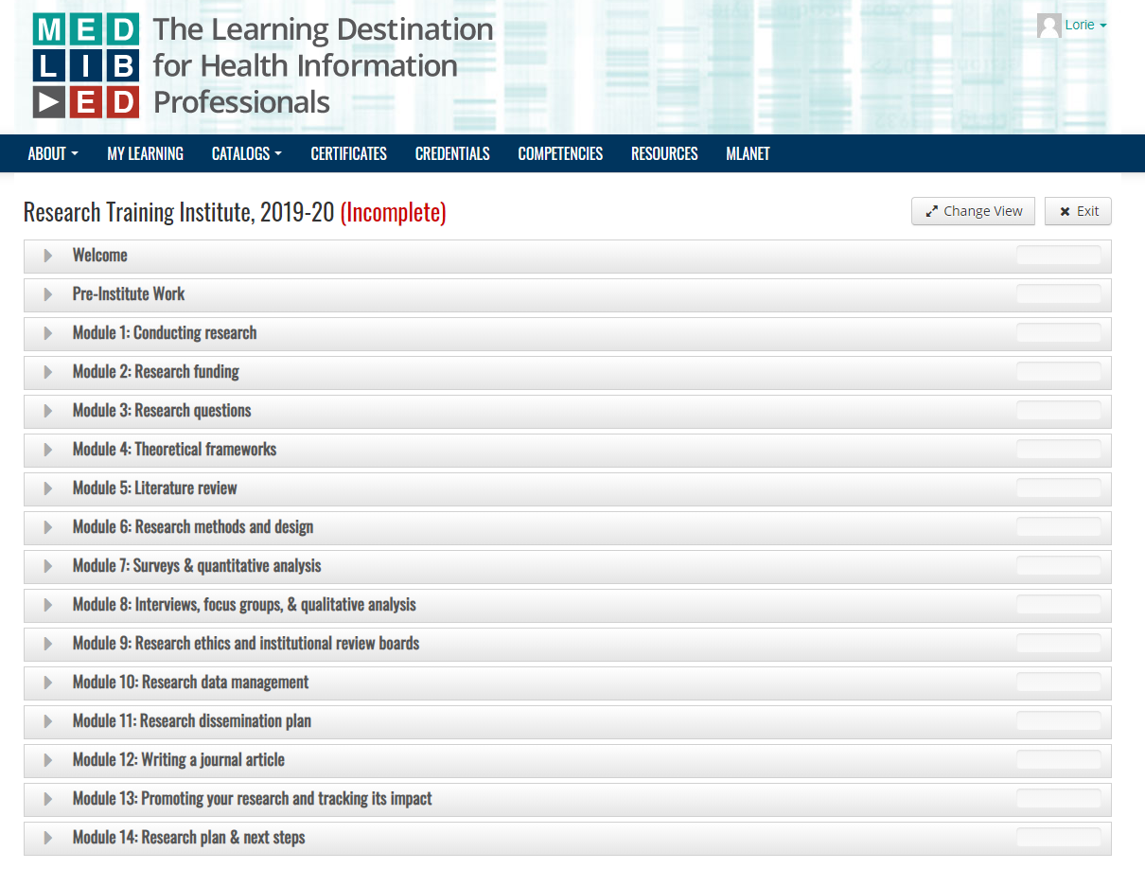
Notes:
A snapshot of the contents of the online course content organization, and modules included in the curriculum

Slide 6
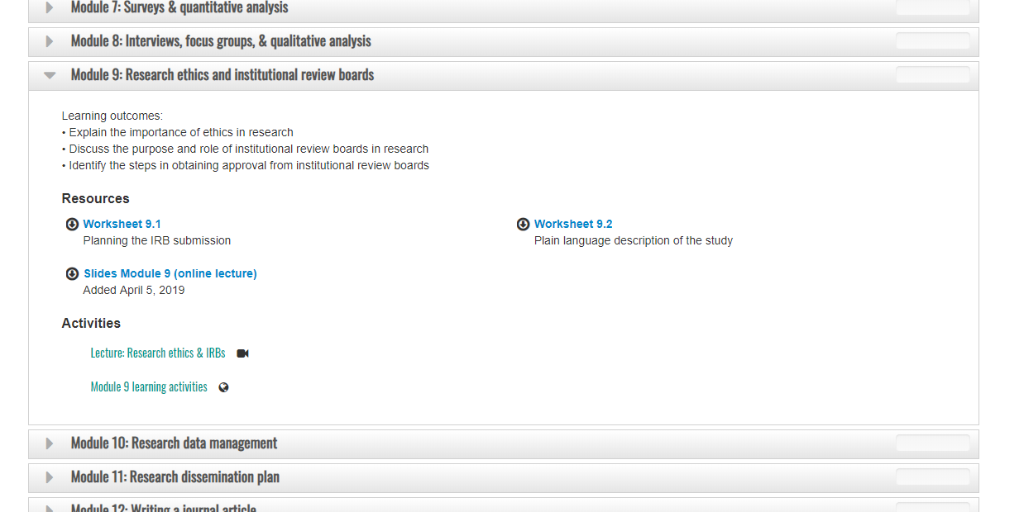
Notes:
Here are the contents of the one of the modules.

Slide 7
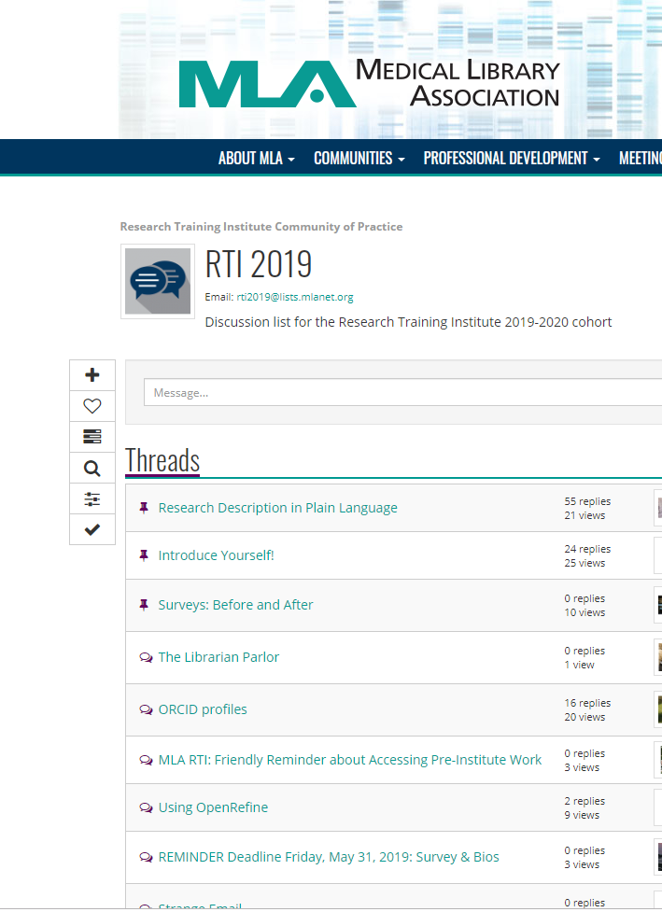
Notes:
A screenshot of a portion of the forum for the community of practice. Several discussion threads – some initiated by the instructors, who also serve as mentors, and some by the participants.

Slide 8
Research Question
Is the Research Training Institute (RTI) effective for improving fellows’ confidence and research output?
Notes:
The RTI began in 2018, and the first group has already completed their year. We have just enrolled the second group of participants this spring, and the face to face workshop will take place again this July.
20 librarians, all with little research experience, participate each year. The RTI refers to participants as “RTI fellows.”
For the first year, we of course wanted to be able to evaluate whether the RTI is reaching its objectives.
To find out, we implemented several assessment methods:
We conducted a pre and post assessment instrument to determine the fellows’ confidence level
We reviewed the fellows most recent quarterly report to determine their progress on their research project
As well as reporting on the perceived impacts of participating in the RTI almost a year later

Slide 9
Fellows Prior Research Experience
Prior research experience since obtaining LIS master’s degree (n=19)
Have conducted research since master’s degree | 12
Prior research publication experience of participants (n=20)
Co-author of research publication in peer-reviewed journal | 6
First author of research publication in peer-reviewed journal | 0
Notes:
Before I answer the research questions, I want to give you little background on the 20 fellows who participated in the first Research Training Institute
We collected and reviewed data about the Fellows’ previous research activities from a survey that was sent prior to the RTI workshop and from reviewing the application data.
12 Fellows’ had conducted research since obtaining an LIS master’s degree.
Of the 12 participants report having conducted research, only half of them reported having published their research in a peer reviewed journal, and none were designated as first authors.
5 out of 6 of the co-authored research publications were systematic reviews. (remember, these are health sciences librarians)

Slide 10
Fellows Prior Research Experience
Prior research experience since obtaining LIS master’s degree (n=19)
Have conducted research since master’s degree | 12
Prior research publication experience of participants (n=20)
Co-author of research publication in peer-reviewed journal | 6
First author of research publication in peer-reviewed journal | 0
Prior research education activities of participants (n=20)
Continuing education programs | 13
Formal master’s degree and information science course | 11
Staff development programs provided by your institution | 6
Self-education activities | 2
Formal degree non-LIS course | 4
Self-education activities | 2
None | 2
Formal doctoral degree LIS course | 1
Notes:
Fellows reported having training in research from various sources
Over half of the participants received research training in a previous continuing education class and/or in a course in their Master’s degree program.
2 participants had never received research training prior to the RTI program.

Slide 11
Reasons for Participating in the RTI
ANSWER CHOICES (N=20) | STRONGLY DISAGREE | DISAGREE | NEITHER AGREE OR DISAGREE | AGREE | STRONGLY AGREE
Will help me contribute to research and scholarship | 0 | 0 | 0 | 3 | 17
Will increase likelihood I will conduct program evaluations and assessments | 0 | 0 | 0 | 6 | 14
Will provide opportunity to partner with and understand the needs of researchers | 0 | 0 | 1 | 6 | 13
Will advance the profession | 0 | 0 | 1 | 7 | 12
Will increase likelihood I will engage in evidence-based decision making | 0 | 0 | 1 | 8 | 11
Will help demonstrate the value of my library to my administration and users | 0 | 0 | 3 | 11 | 6
Will support my tenure and/or promotion efforts | 0 | 1 | 4 | 9 | 6
Notes:
We also asked them state their reasons for attending the RTI.
All participants agreed or strongly agreed that the RTI will help them contribute to research and scholarship.
All participants agreed or strongly agreed that the RTI will increase the likelihood that they will conduct program evaluations and assessments.
Most participants agreed or strongly agreed with every reason listed.
The lowest ranked reason for attending was to support their tenure and/or promotion efforts.

Slide 12
Confidence Levels of Participants
A pre- and post- assessment instrument based on Librarian Research Confidence Scale (LRCS-10) (Brancolini & Kennedy, 2017)
Pre-assessment survey: 9 weeks prior to workshop: May 3-31, 2018
Post-assessment survey: 4 weeks after workshop: August 14-31, 2018
Used the Wilcoxon Signed Ranks Test to determine if there was statistically significant difference in the self-reported research confidence of the fellows before and after the RTI workshop
Notes:
Now, to answer our research question.
The pre-and post-assessment surveys were based on the Librarian Research Confidence Scale by Brancolini & Kennedy used for the Institute for Research Design in Librarianship, - another US institute for increasing librarians’ research capacity (but not specific to health sciences). The fellows were asked to rate 26 items relating to research skills on a Likert scale from 5: Very Confident; 4 Confident; 3 Moderately Confident; 2 Slightly Confident; and 1 Not At All Confident.
The pre-assessment survey was sent out 9 weeks prior to the RTI workshop and the post-assessment survey was sent out 4 weeks after the RTI workshop. We analyzed the data using the Wilcoxon Signed Ranks Test to determine if there was statistically significant difference in the self-reported research confidence before and after the workshop, and the results are presented in the following slides.
For every item on the assessment, the post-workshop research confidence was significantly higher than the pre-workshop research confidence.

Slide 13
Confidence Levels of Participants (1)
Scored with Likert scale: 5: Very Confident; 4 Confident; 3 Moderately Confident; 2 Slightly Confident; 1 Not At All Confident
Questions about skills needed for a research project | Median Rating (Pre) | Median Rating (Post) | Z score | p-value
1. Turning my topic into a question. | 3 | 4 | -3.087 | .002
2. Designing a project to answer my question. | 2.5 | 4 | -3.630 | .000
3. Selecting methods and procedures for my question. | 2 | 3 | -3.352 | .001
4. Developing plan and timeline for my study. | 2 | 4 | -3.534 | .000
5. Identifying appropriate information sources in which to conduct my literature search. | 4 | 5 | -2.221 | .026
6. Using relevant keywords and search strategies to discover literature about the research topic. | 4 | 5 | -2.804 | .005
7. Assessing and synthesizing literature that is relevant to your research question. | 3 | 4 | -2.984 | .003
8. Using a theoretical framework to inform the research design of your study. | 1 | 3 | -3.022 | .003
Notes:
Median ratings increased 1-2 points for each item.
Point out the items for which the ratings were very low pre-workshop
8. theoretical framework

Slide 14
Confidence Levels of Participants (2)
Scored with Likert scale: 5: Very Confident; 4 Confident; 3 Moderately Confident; 2 Slightly Confident; 1 Not At All Confident
Questions about skills needed for a research project | Median Rating (Pre) | Median Rating (Post) | Z score | p-value
9. Identifying sources of research funding and funding agency requirements. | 2 | 3 | -3.570 | .000
10. Choosing an appropriate data gathering procedure. | 2 | 3.5 | -4.011 | .000
11. Determining which members of a population to include in your study. | 2 | 4 | -3.672 | .000
12. Knowing how to design a focus group. | 2 | 3 | -3.804 | .000
13. Knowing how to run a focus group. | 2 | 3 | -3.682 | .000
14. Knowing how to design an interview. | 2 | 4 | -3.685 | .000
15. Knowing how to conduct an interview. | 2 | 4 | -3.499 | .000
16. Knowing how to design a survey. | 2 | 4 | -3.839 | .000
17. Knowing how to administer a survey. | 2.5 | 4 | -3.250 | .001
18. Knowing institutional processes and standards to ensure that your study is conducted ethically. | 3 | 4 | -3.274 | .001

Slide 15
Confidence Levels of Participants (3)
Scored with Likert scale: 5: Very Confident; 4 Confident; 3 Moderately Confident; 2 Slightly Confident; 1 Not At All Confident
Questions about skills needed for a research project | Median Rating (Pre) | Median Rating (Post) | Z-score | p-value
19. Knowing what method of data analysis you would use for your study. | 1 | 3 | -3.668 | .000
20. Knowing what type of assistance you might need to undertake data analysis (e.g., data/statistics consulting, transcription, software). | 2 | 4 | -3.809 | .000
21. Knowing how to manage the data you have gathered. | 2 | 3.5 | -3.668 | .000
22. Knowing how to code qualitative data to identify themes and sub-themes. | 1 | 3 | -3.660 | .000
23. Reporting results in written format. | 2 | 3 | -3.486 | .000
24. Reporting results verbally. | 2 | 3 | -3.463 | .001
25. Identifying appropriate places to disseminate results. | 3 | 4 | -3.640 | .000
26. Tracking the dissemination and impact of your research. | 3 | 4 | -3.458 | .001
Notes:
19, choice of data analysis method
22. Coding qualitative data
Not surprisingly, the median rating of the fellows’ research confidence was highest on items related to literature searching before and after the workshop.
The median rating of the fellows’ research confidence increased by two points on 9 items:
Activities on developing a research plan, designing surveys, and conducting interviews could be the reason for the increase in those areas. Additionally, many of the fellows rated their confidence in theoretical frameworks as low prior to the workshop, but the lecture and activity on this topic helped to increase their confidence.
The survey results helped the RTI team to focus on areas where we would like to increase the fellows’ confidence even more, such as:
included new hands-on activities on quantitative and qualitative data analysis
reduced amount of content on lit reviews
moved lecture-based content (lit review, research data management, research dissemination) to online prework to allow for more workshop activities for activities that scored “slightly confident” in the survey

Slide 16
Research Progress of 2018 RTI Fellows
7
Problem Identified
Literature Review
Research Method Design
IRB Approval (if applicable)
Data Collection
Research Questions
Write-Up
Data Analysis
5
4
1**
2**
1**
**Had to postpone research projects due to job changes and/or work-related issues.
15/20 fellows submitted e-posters about their research projects for the MLA Annual Meeting in May 2019.
Notes:
The third quarter reports submitted by the RTI 2018 fellows on April 15, 2019 were analyzed to establish their current progress on their project.
7 out of 20 (35%) have completed their data analysis and are preparing manuscripts for submission to journals.
12 out of 20 (60%) have completed IRB approvals and data collection and are currently analyzing results.
We were very pleased to see that almost all of the fellows submitted e-posters for MLA 2019, and they presented brief ignite talks about their research projects to garner interest in their work.

Slide 17
Impact of RTI on 2018 Fellows & their Institutions
Type of Impact | Frequency
Formed internal and external research collaborations | 13
Shared RTI experience with colleagues through informal and formal venues | 12
Provided leadership to strengthen research capacity | 9
Strengthened relationships with individuals outside of the library | 8
Increased visibility of the library and its services | 7
Improved or initiated new library services | 6
Gained a better understanding of the users served | 5
Received recognition for research | 5
Decided to pursue more research education | 4
Participated in other research activities | 4
Increased confidence in conducting research | 3
Developed research support materials | 2
Impacted way research is conducted at institution | 1
Gained institution’s interest in study findings | 1
Increased the research culture at institution | 1
Impact of RTI on Fellows & their Institutions
Notes:
We also reviewed the third quarterly reports (submitted by the RTI 2018 fellows on April 15, 2019) to identify RTI impacts on the Fellows’ professional activities and their institutions.
The data provides some quantitative evidence that RTI training positively impacted Fellows’ professional relationships, built influence with user communities, and enhanced library services.
It is also interesting to note that in one instance a Fellow’s research project created new research policies and procedures that were implemented throughout their hospital.

Slide 18
Conclusion
Looking at the 2018 results, we have evidence that:
  RTI increased the research confidence of the participating fellows
  The majority of RTI fellows have made significant progress on their research projects, and over one-third are working on article manuscript submissions.
  As a result of the RTI, fellows report an increase in likelihood of:
    Contributing to scholarship
    Conducting program evaluations and assessments
    Engaging in evidence-based decision making

Slide 19
References
Brancolini, K.R., & Kennedy, M.R. (2017). The development and use of a research self-efficacy scale to assess the effectiveness of a research training program for academic librarians. Library and Information Research, 41(24), 44-84. https://doi.org/10.29173/lirg760
Evidence you can use to communicate library value [Internet] Chicago, IL: MLA; [cited 13 Apr 2019]. <https://www.mlanet.org/p/cm/ld/fid=1361>.
Lessick, S., Perryman, C., Billman, B.L., Alpi, K.M., De Groote, & S.L., Babin, T.D. Jr. (2016). Research engagement of health sciences librarians: A survey of research-related activities and attitudes. Journal of the Medical Library Association, 104(2):166-73. doi: 10.3163/1536-5050.104.2.015
Marshall, J.G. (2014). Linking research to practice: the rise of evidence-based health sciences librarianship. Journal of the Medical Library Association, 102(1):14–21. doi: 10.3163/1536-5050.102.1.005
Plutchak, T.S. (2005). Building a body of evidence. Journal of the Medical Library Association, 93(2), 193–195. PMID: 15858620

Slide 20
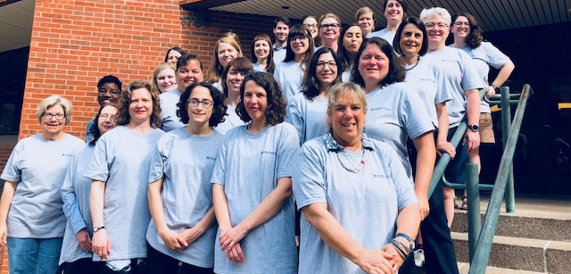
Thank You 2018 RTI Fellows!

Slide 21
Comments/Questions?
For additional information about RTI:
  RTI web site
    MLANET, under “Professional Development” link at top of page
    http://www.mlanet.org/p/cm/ld/fid=1333
Contact Us:
  Jodi Philbrick (Jodi.Philbrick@unt.edu)
  Lorie Kloda (lorie.kloda@concordia.ca)
  Susan Lessick (slessick@uci.edu)
This project was made possible in part by the Institute of Museum and Library Services (RE-95-17-0025-17).
Notes:
The RTI website is the central place where we highlight the work of the Institute and the research activities of the Fellows.
I hope you get a chance to visit the site to learn more about the RTI program.
Thank you all for coming to our presentation.

Slide 22
RTI Program Features
Objective application process
IMLS, AAHSL, and MLA scholarship support for RTI Fellows
  5-member teaching faculty
Research instruction program designed to meet the special needs of health sciences librarians
Research projects of Fellows address research questions, topics, and populations of importance and interest to HS librarians
Structured mentor-based support after workshop as Fellows complete research projects
Active online RTI Community of Practice
Capstone research presentation
Comprehensive assessment plan
Notes:
Mention that this is funded by the IMLS in the USA
The RTI program is multifaceted with a number of unique features.
Selection process for RTI ensures fair and unbiased evaluation of applicants.
Review process is conducted independently by RTI Jury that is appointed by MLA Board of Directors.
Process includes a double-blind review and the use of a strict research-based protocol to evaluate all applications.
RTI Jury review process is assessed at the end of each cycle to evaluate methods and practices.
Numerous scholarships are funded by IMLS, AAHSL and a growing list of MLA sections and chapters.
Scholarship recipients are selected using a strict research-based protocol.
RTI faculty is a carefully selected group of faculty and practitioners with specialist expertise in health information research and evidence based practice.
RTI program focuses on research competencies, issues, practices, and strategies related to HS librarianship.
Examples of domain-specific issues: non-standard IRB review procedures in hospitals; confidentiality, privacy, and security of health information.
5. Research questions, research topics, and populations studied are of importance and interest to HS librarians.
Examples of projects: factors that effect clinical/patient referrals to medical libraries; publishing practices of early career clinicians and researchers; and medical students’ use of Wikipedia editing to improve information literacy (IL) skills.
All instructors serve as mentors to Fellows during the Institute and afterwards as the Fellows conduct their research projects at their home institutions. Mentors assist with ongoing learning and research projects, and encourage research progress, completion, and dissemination of research findings.
Fellows actively participate in an online RTI Community of Practice.
Community of Practice is available on the MLANET platform and integrated with MEDLIB-ED (MLA’s learning management system) and other relevant MLA tools and resources.
CoP is a vehicle for Fellows to share experiences, identify solutions to common problems, gain knowledge and confidence, and reduce professional isolation.
Program provides a capstone opportunity for each Fellow to present their research work and findings at the MLA annual conference.
All aspects of the RTI program are evaluated to support Fellows’ research learning, progress, and achievement.

