Slide 1
Embedding Graduate LIS Students into the MLA Research Training Institute (RTI): An Unique Model for Research Methods Education
Ana D. Cleveland, PhD, AHIP, FMLA
Regents Professor, Sarah Law Kennerly Endowed Professor, & Director, Health Informatics Program, Department of Information Science, University of North Texas
Jodi L. Philbrick, MSLS, PhD, AHIP
Principal Lecturer, Department of Information Science, University of North Texas
Emily Vardell, MLS, PhD, AHIP
Assistant Professor, School of Library and Information Management, Emporia State University
Susan Lessick, MA, MLS, AHIP, FMLA
Project Director, MLA Research Training Institute
Librarian Emerita, University of California, Irvine

Slide 2
Overview of MLA Research Training Institute
Cohort 1
2018 –2019
20 fellows
5-day institute at UIC
Cohort 2
2019 –2020
Cohort 3
2020 – 2021
Cohort 4
2021 - 2022
32 fellows
Online with 16 modules
20 fellows
5-day online institute
20 fellows
5-day institute at UIC
Cohort 5
2022-2023
32 fellows
Online with 16 modules
Funded by 3-year IMLS Laura Bush 21st Century Librarian Grant
Funded by MLA
Funded by 3-year IMLS Laura Bush 21st Century Librarian Grant

Slide 3
Goals of MLA Research Training Institute
Increase research competencies
Increase research quality, quantity, and dissemination
Build research capacity to contribute to health and library improvements
Notes:
Librarian-led health information research supports quality health care and library practice. Despite the benefits of research, access to research methods education is limited and more rigorous research training is critically needed to instruct health library practitioners.
The MLA Research Training Institute program aims to address this educational gap by increasing the research competencies, confidence, quality, and productivity of health sciences librarians throughout the country.
The broad goals for the RTI program are to:
increase the research competencies & confidence of participants
increase quantity, quality, and communication of health information research conducted by health sciences librarians
AND to build research capacity among health sciences librarians to contribute to health and library improvements.

Slide 4
Features of the 2021-2022 Online Research Training Institute
One-year institute that includes:
16 synchronous learning modules and asynchronous learning content & activities covering all stages of designing, implementing, and publishing a health information research project
Mentoring & check-in points throughout the year
Peer coach support program
Online community of practice
Capstone presentation at MLA Annual meeting
+ Embedded Graduate Student Program!
Notes:
RTI learning model addresses this gap by delivering:
An immersive training experience consisting of 16 synchronous learning modules and asynchronous learning content & activities - Delivered by 5 primary instructors & 1 additional instructor.
Mentoring and monitoring throughout the year complete their research projects
Peer coach support program with previous RTI fellows serving as peer coaches for current fellows
Encouragement and collegiality through an online Community of Practice
Capstone experience that includes a public presentation of the Fellows’ research work through posters at an MLA annual conference.
The timeline of the RTI is that it takes place over a year. Participants (26 HS librarians, 6 LIS students – 4 from UNT & 2 from ESU) are enrolled in the spring (May). After the workshop, the participants work on their research projects at the own pace and are invited to present, at whatever point they are at, in May of the following year at the annual meeting.
Note that the RTI learning model was designed by a group of LIS professionals and faculty researchers in the health sciences. The RTI instruction is delivered entirely by health sciences librarians and LIS faculty.

Slide 5
Embedded Graduate Student Program
Pilot research methods education project for graduate students from UNT and ESU
Serves as a model for other master’s programs to improve the quality of research methods instruction.

Slide 6
Academic Partners

Slide 7
Structure of the Embedded Graduate Student Program
6
Student Fellows
MLA Leadership Team & Project Director
5 Peer Coaches
2 Academic Liaisons
6 RTI Faculty
(5 Primary Mentors)

Slide 8
Unique Features for Graduate Students
Students receive both advanced research methods instruction and hands-on experiential learning activities
Students receive academic credit for their participation in the RTI
Academic liaisons from each university meet individually with students about their progress; progress report filed with co-lead faculty and project director
Small group meetings with students, academic liaisons, and project director outside of regular RTI sessions
Notes:
6 credit hours at UNT – INFO 5900: Health Information Research Methods I (Summer) & INFO 5900: Health Information Research Methods II (Fall)

Slide 9
Small Group Meetings
Date | Discussion Topics
June 3, 2021 | Student introductions Purpose of students’ meetings
June 29, 2021 | Evolution of research topic since starting RTI Main challenges in conducting research What surprised you most since starting RTI
August 3, 2021 | Final research topic in 30 seconds or less First 3 items on the to-do list Communication plan with mentors
September 14, 2021 | Progress on research projects Next item on the to-do list Balancing coursework with the RTI
November 9, 2021 | Progress on research projects Benefits from the RTI experience Lessons learned from the research process

Slide 10
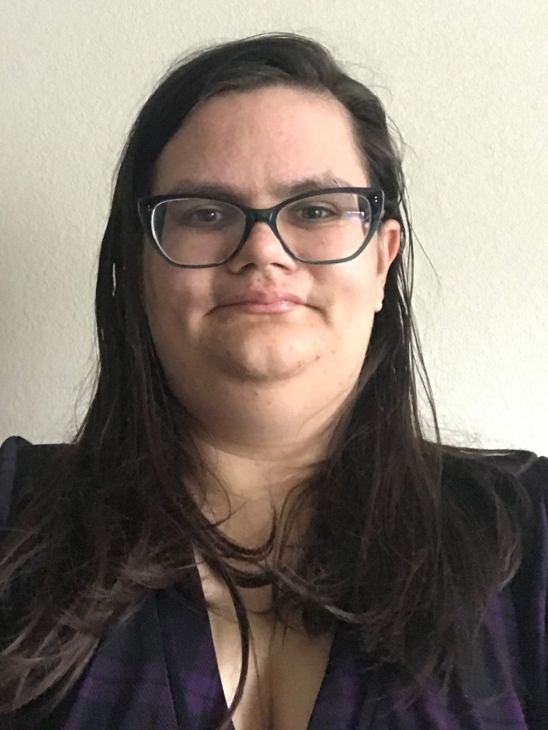
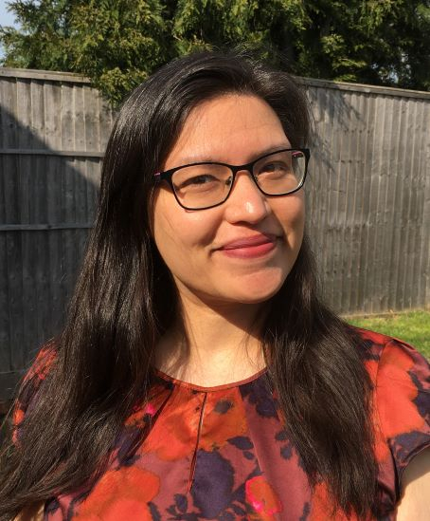
2021 Graduate Student Fellows
Mary Catherine Ellis
Topic: “A Content Analysis of Online Autism Health Information”
Mentor: Mark MacEachern
Peer Coach: Robin O’Hanlon
Curtis Kennett
Topic: “Depression and LIS Training: A Cultural Consensus Analysis of Depression Within Texas LIS Programs”
Mentor: Katherine Akers
Peer Coach: Laura Menard
Carmela Preciado
Topic: “Perspectives of First-Generation Immigrants Access to Healthcare in Central Texas”
Mentor: Mark MacEachern
Peer Coach: Robin O’Hanlon
E. Bailey Sterling
Topic: “Board Games as Effective Disaster Information Literacy Tools for Children”
Mentor: Emily Vardell
Peer Coach: Natasha Williams

Slide 11
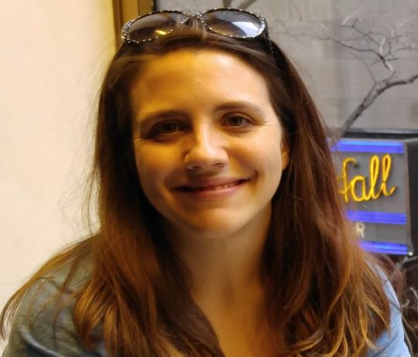
2021 Graduate Student Fellows
Andrea Dater
Topic: “Understanding the Institutional Review Board Submission Process: A Content Analysis of IRB Submission Forms of RTI Participants, 2018-2020”
Mentor: Jodi Philbrick
Peer Coach: Hilary Jasmin
Mary Margaret Thomas
Topic: “Mental Health First Aid (MHFA) Training: A Librarian’s Perspective”
Mentor: Shanda Hunt
Peer Coach: Ying Zhong

Slide 12
What We’ve Learned So Far…
Student fellows have gained confidence in two areas:
Their own research ability
Interacting with non-student fellows in the RTI (practicing health sciences librarians)
Student fellows have benefited from the interaction with each other
Students have learned the benefits of research collaboration and engagement with other students
Student fellows have learned about the practicalities of doing research
Access to population/sample
IRB process
Time management

Slide 13
Comments/Questions?
For additional information about RTI:
RTI web site
MLANET, under “Professional Development” link at top of page
http://www.mlanet.org/p/cm/ld/fid=1333
Contact Us:
Ana D. Cleveland (ana.cleveland@unt.edu)
Jodi Philbrick (jodi.philbrick@unt.edu)
Emily Vardell (evardell@emporia.edu)
Susan Lessick (slessick@uci.edu)
This project was made possible in part by the Institute of Museum and Library Services (RE-246568-OLS-20).
Notes:
The RTI website is the central place where we highlight the work of the Institute and the research activities of the Fellows.
We hope you get a chance to visit the site to learn more about the RTI program.
Thank you all for coming to our presentation.

