Slide 1
Deepening Research Capacity of Health Sciences Librarians: Effectiveness of the MLA Research Training Institute (RTI) Online Program
Susan Lessick, MA, MLS, AHIP, FMLA
Project Director, MLA Research Training Institute
Librarian Emerita, University of California, Irvine, USA
Jodi L. Philbrick, MSLS, PhD, AHIP
Principal Lecturer
University of North Texas, Denton, USA
Emily Vardell, MSLS, PhD, AHIP
Associate Professor
Emporia State University, Olathe, Kansas, USA
Ana Cleveland, PhD, AHIP, FMLA
Regents Professor & Sarah Law Kennerly Endowed Professor
University of North Texas, Denton, USA
MLA ‘23, Detroit, May 2023
Notes:
I am Susan Lessick, the RTI Project Director and I am here today on behalf of my co-authors, two of whom are the lead instructors of the RTI online program (Jodi and Emily), and the other who is the academic coordinator of the program (Ana).
I am going to present on the MLA RTI program, which was launched in 2018 and then transitioned to a fully online research training program in 2021.
The presentation will give you some background information on the program and then focus on several assessment activities for the RTI online program for the years 2021 and 2022.

Slide 2
Features of RTI online program
Advanced research curriculum, including 16 online modules (~24 hours) and supporting resources
Mentoring and peer coaching support
Online community of practice
Two directed experience-based learning opportunities:
Completion of an original health information research project
Capstone presentation at MLA annual meeting
7 faculty experts and 5 peer coaches (previous RTI graduates)
Received national recognition – two IMLS grants
Academic partnerships with LIS master’s programs
Notes:
The RTI program includes:
pre-foundational work prior to the institute which takes place in the month of May
9 summer core modules delivered on a weekly basis, June through July after which fellows begin to conduct their research projects
and 7 additional online modules (one per month) that are taught September through April.
Program supports throughout the year include mentoring by faculty mentors and peer coaches, participation in an online community of practice, and a capstone presentation at the MLA annual meeting.
26 librarians and 6 LIS graduate students attended the RTI ‘21 online program, and 26 librarians and 8 graduate students are attending RTI ‘22.
Note that the RTI was designed by a group of LIS professionals and faculty researchers in the health sciences. The RTI instruction is delivered entirely by librarians and LIS faculty – 7 faculty experts and 5 peer coaches.
The RTI is unique to the profession of librarianship (first LIS research fellowship program offered in U.S).
Between 2018 and 2022 the RTI received national recognition through two 3-year grants from the Institute of Museum and Library Services (IMLS), underscoring RTI’s broad impact and significance.
RTI is supported by academic partnerships with the University of North Texas and Emporia State University, which offer unique opportunities to draw from the respective strengths and expertise of both the RTI community and academic institutions.
Our RTI program models and promotes high-quality research education and capacity building for LIS continuing education AND formal LIS graduate-level programs.

Slide 3
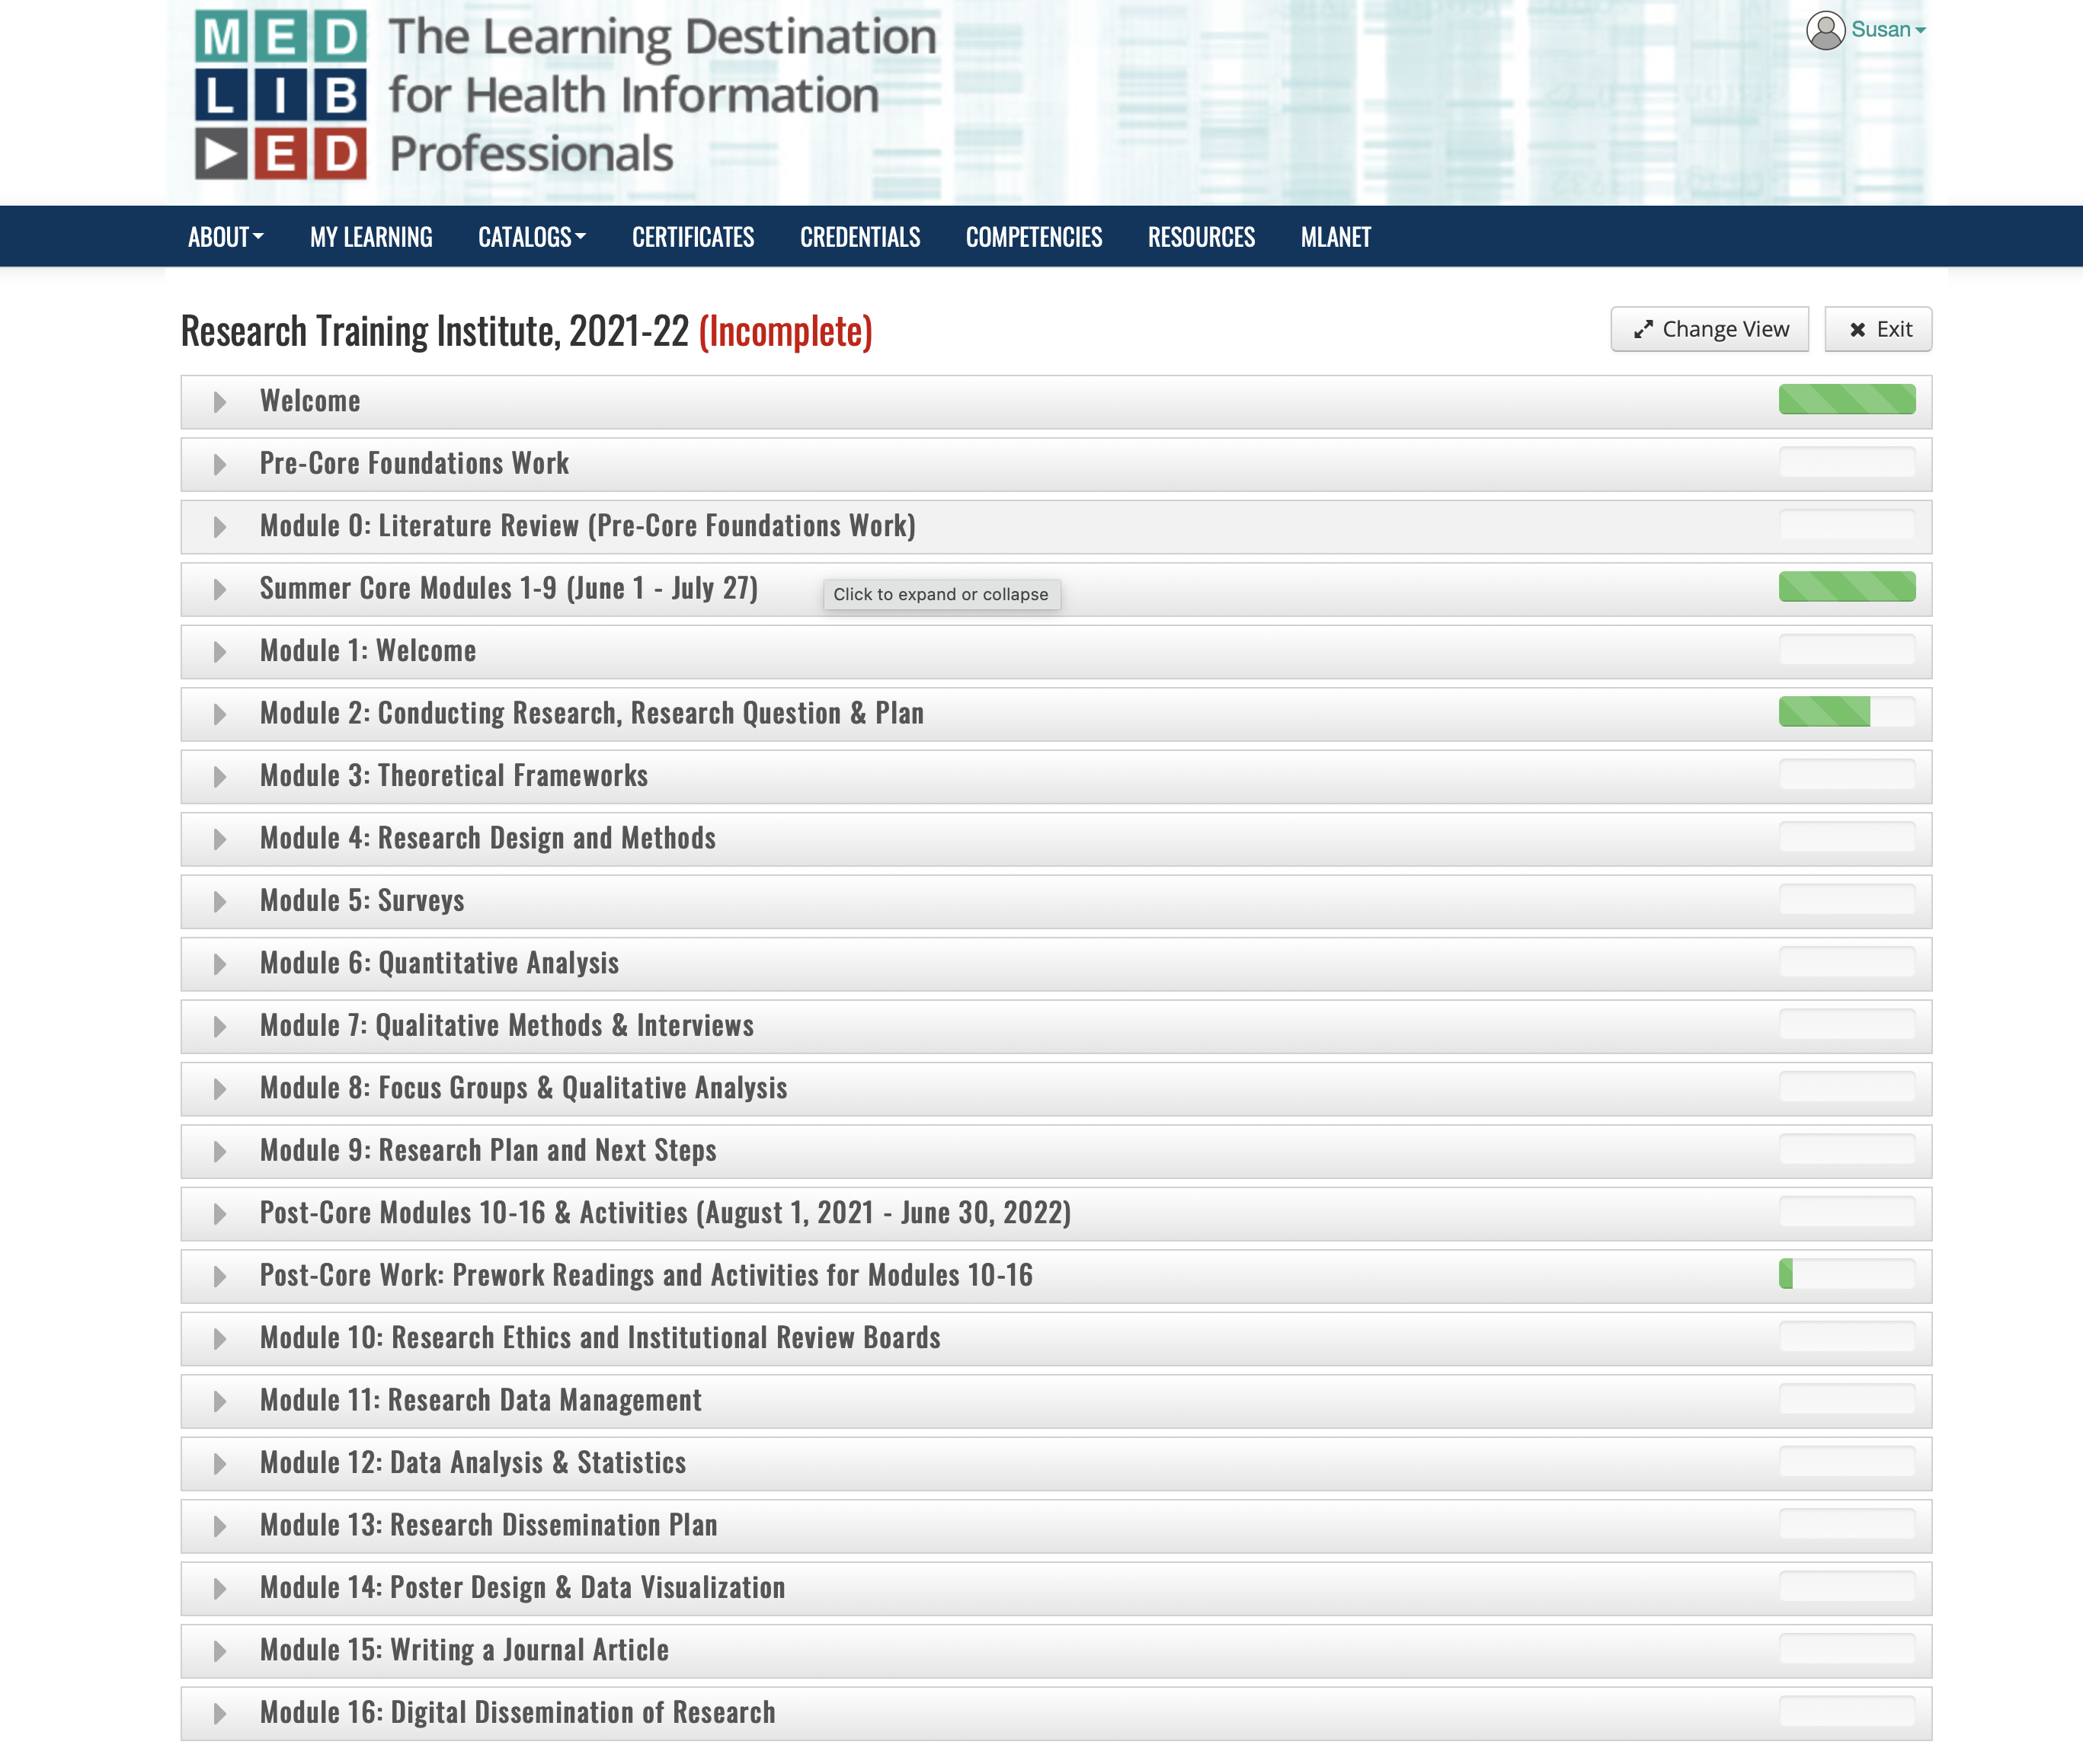
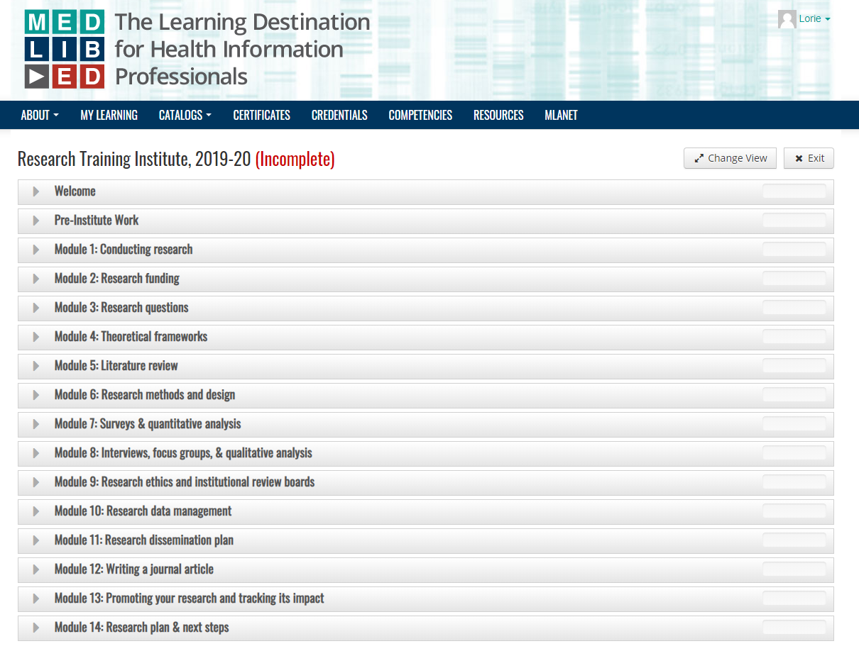
Notes:
Here is a snapshot of the contents of the online course content, organization, and modules included in the curriculum.

Slide 4
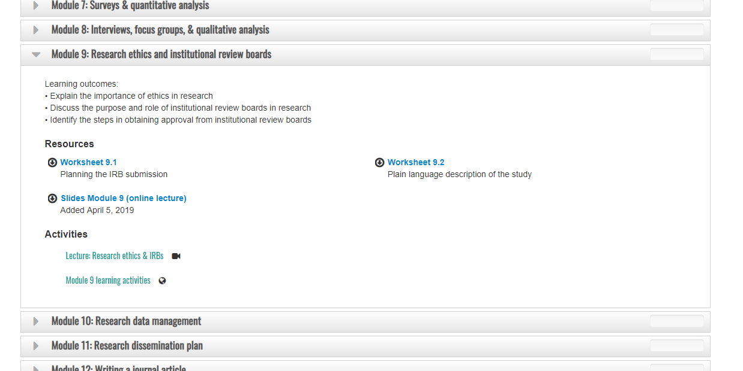
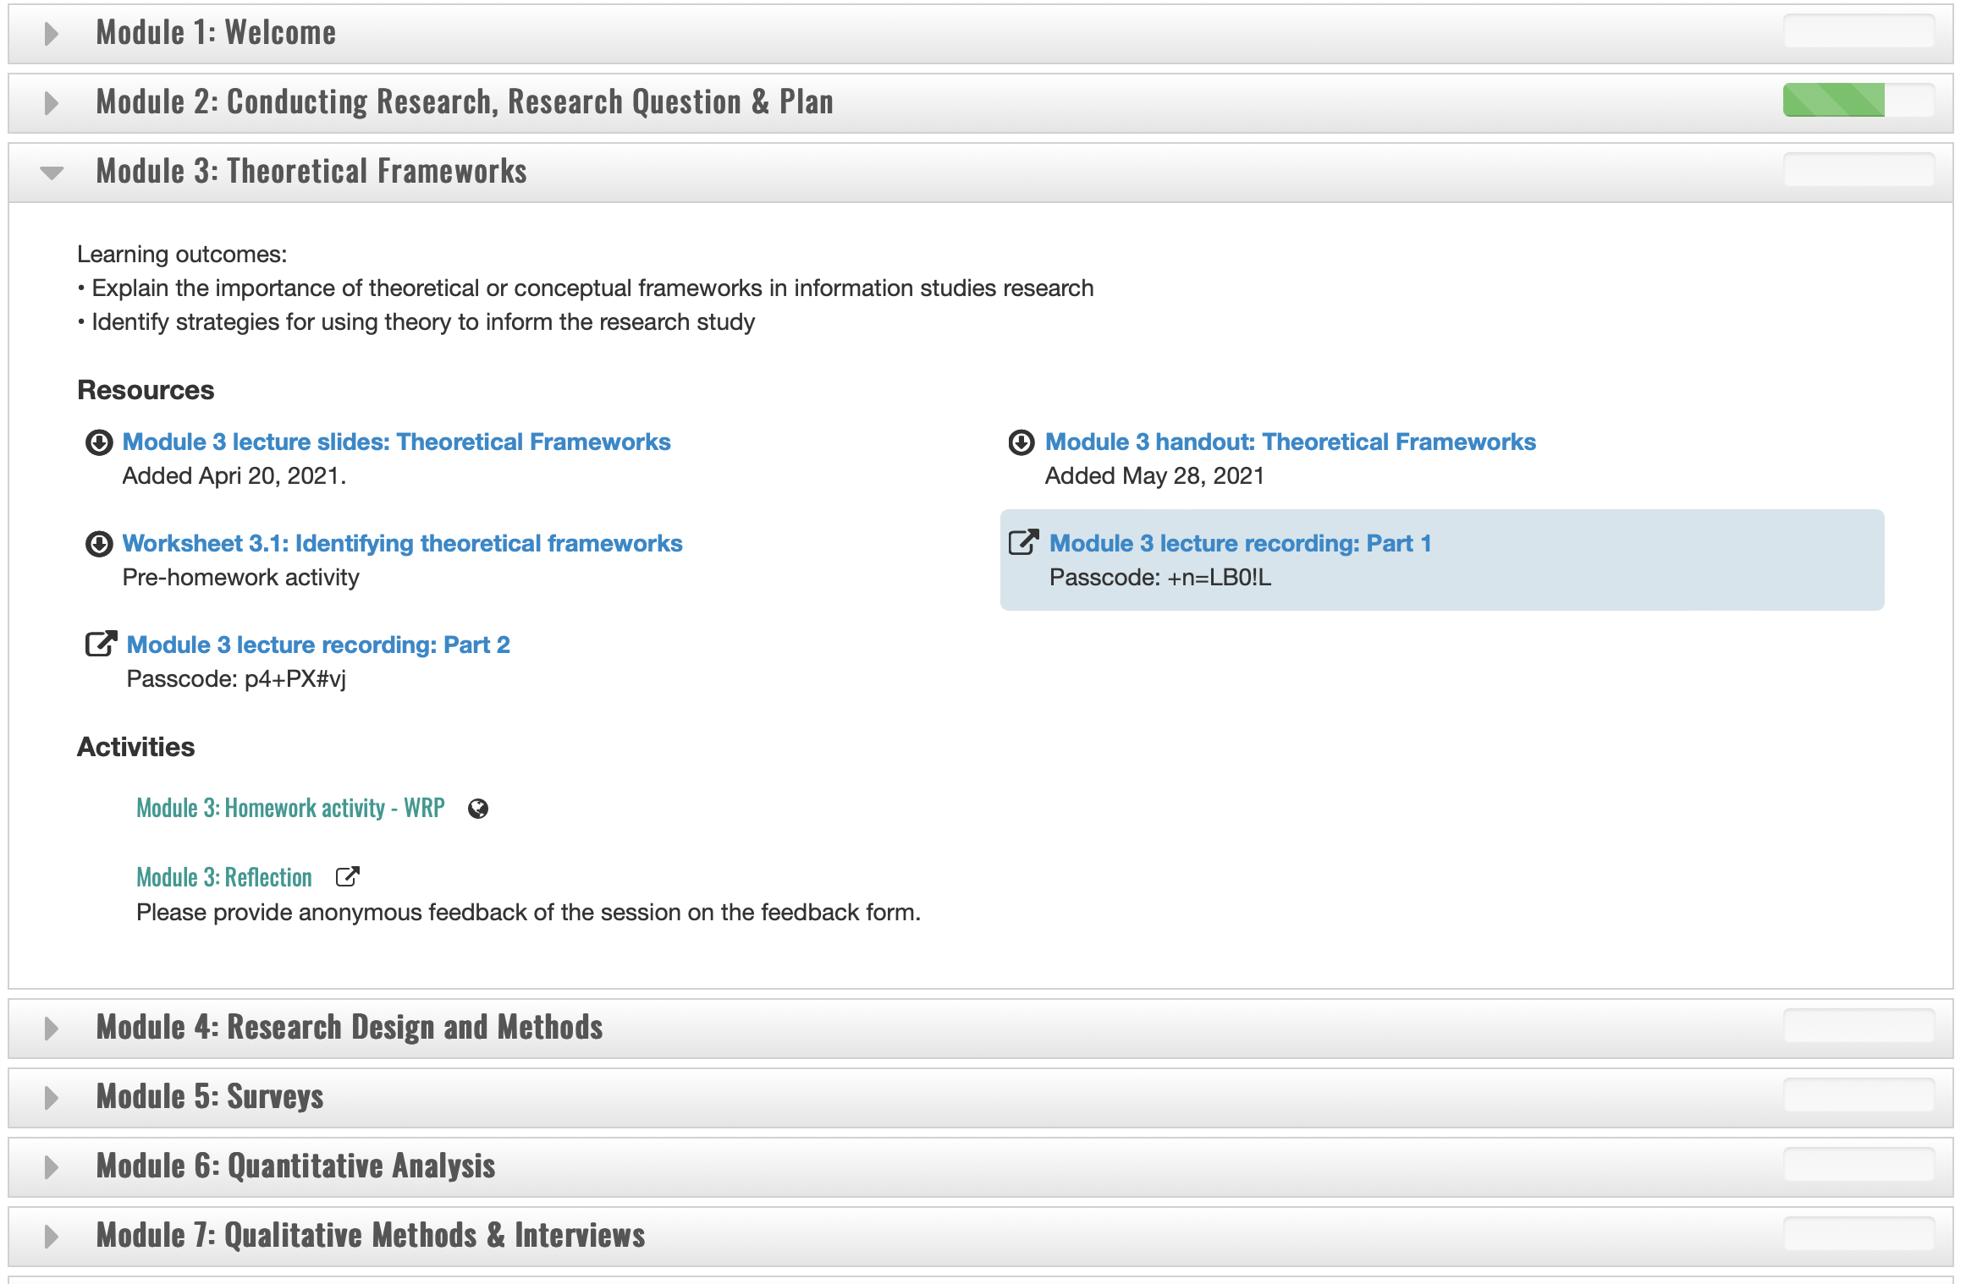
Notes:
Here are the contents of one of the modules – Theoretical Frameworks.

Slide 5
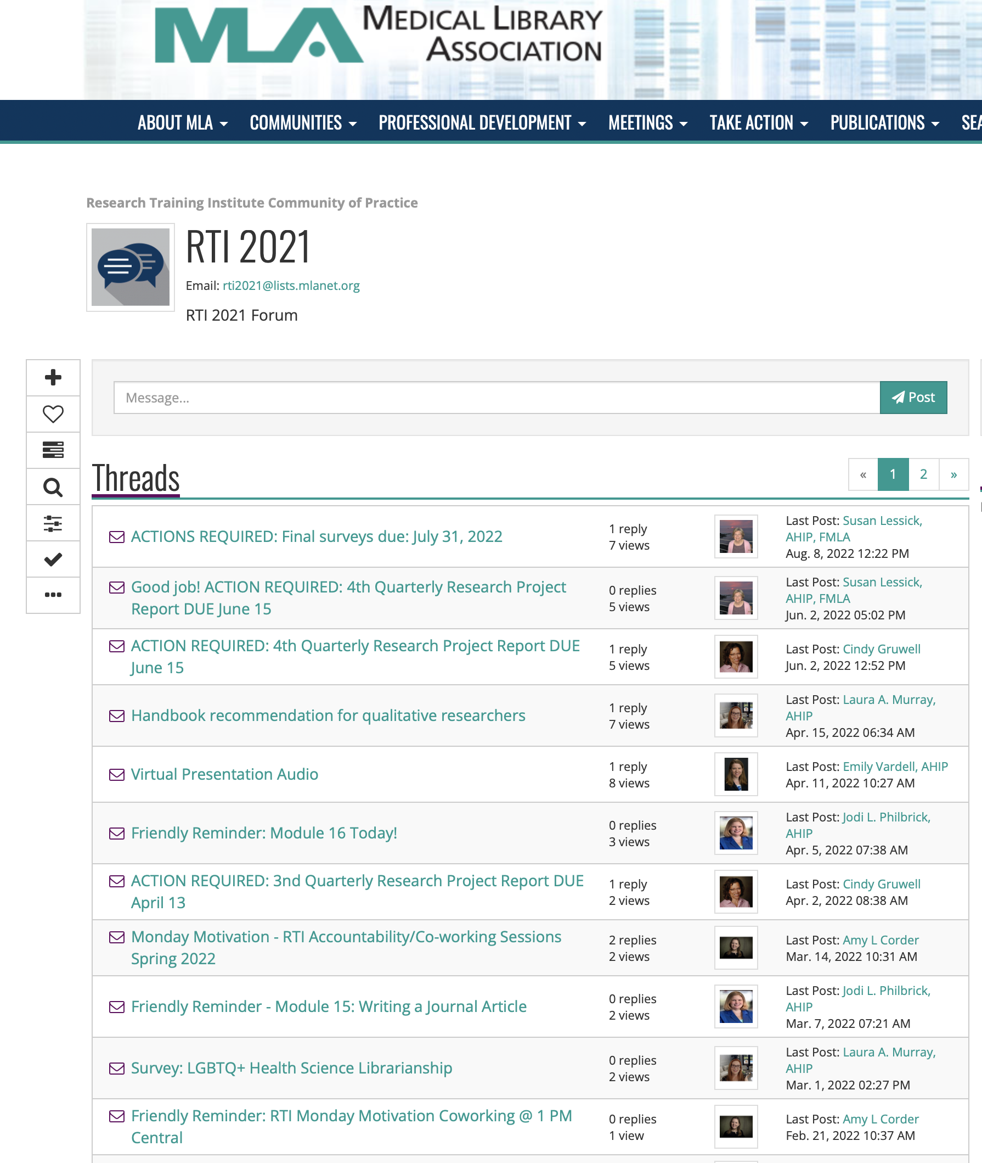
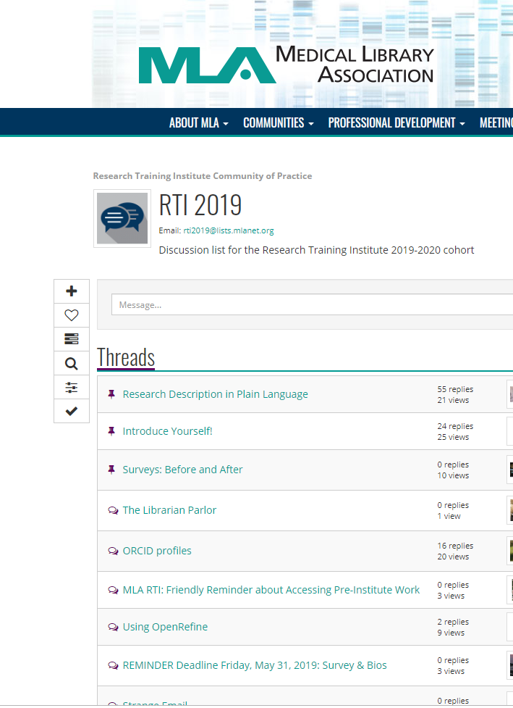
Notes:
This is a screenshot of a portion of the forum for the community of practice with several discussion threads – some initiated by the instructors, who also serve as mentors, and some by the participants.

Slide 6
Multiple Assessments of Program Effectiveness (RTI ’21 & ‘22)
Prior research engagement of participants (2021 & 2022)
Research confidence of participants across 3 time points
Pre- and midpoint confidence assessment (2021 & 2022)
Pre- and one-year after assessment (2021)
Participant perceptions re program performance and learning outcomes (2021)
Participant perceptions of program impacts (2021)
A full discussion of results is available: https://www.mlanet.org/p/cm/ld/fid=1460
Notes:
We implemented multiple assessments for the RTI ‘21 and ‘22 programs. The five assessments on this slide are the ones that I am reporting on today:
Prior research education & engagement of participants
Research confidence levels across 3 time points; pre-institute (in May), at midpoint (after the first 9 core modules in August), and one year after the conclusion of the core modules (the following July/August).
Participant perceptions of program performance and learning outcomes.
Participant perceptions of RTI program impacts.
All five assessments have been completed for RTI 2021. Only 2 have been completed for RTI 2022 since the current 2022 institute year does end until June.
Lastly, due to time constraints I will only be sharing some of the key highlights of the assessment results on the following slides.
Complete notes and more fullsome discussion of results will be available on the RTI Dissemination and Impact page at link on the slide:
https://www.mlanet.org/p/cm/ld/fid=1460

Slide 7
Research Questions
What were RTI 2021 and 2022 participants’ prior research education and experience?
Were the RTI 2021 and 2022 online programs effective for increasing fellows’ research confidence at midpoint in the program (after the core modules)?
Was the the RTI 2021 online program effective in increasing the research confidence of RTI fellows after one year of participation?
What were RTI 2021 participants’ perceptions concerning key performance and learning outcomes? Did these perceptions affirm the research confidence findings?
What were RTI 2021 participants’ perceptions of the impact of the RTI program?
Notes:
Here are the five research questions that our assessment methods aim to answer. I won’t read them all but will let you review them on the slide.

Slide 8
RTI Fellows’ Prior Research Education & Experience (Librarians)
PRIOR RESEARCH EXPERIENCE & EDUCTION | Cohort 1 2018 | Cohort 2 2019 | Cohort 3 2020 | Cohort 4 2021 | Cohort 5 2022
Prior research education activities of participants | (N=20) | (N=20) | (N=20) | (N=26) | (N=26)
Formal master’s degree and information science course | 11 | 9 | 13 | 20 | 20
Continuing education programs | 13 | 13 | 9 | 20 | 16
Self-education activities | 2 | 12 | 11 | 21 | 17
Formal degree non-LIS course | 4 | 6 | 6 | 11 | 6
Staff development programs provided by your institution | 6 | 1 | 3 | 8 | 7
Formal doctoral degree LIS course | 1 | 0 | 1 | 0 | 0
None | 2 | 1 | 1 | 0 | 3
Have conducted research since master’s degree? | (N=19) | (N=20) | (N=20) | (N=26) | (N=26)
 | RESPONSES %
Yes | 63 | 55 | 25 | 62 | 65
No | 37 | 45 | 75 | 38 | 35
Notes:
Let’s look at some the highlights of the results of the first assessment - prior research education and experience of librarian participants…I am displaying results for all five cohorts.
Librarian Fellows reported that they have had training in research from various sources.
Over 75% in Cohort 4-5 received research training in a LIS master’s course.
Over half of the participants in both cohorts participated in research-related continuing education programs.
Over half of the participants in both cohorts participated in self-education activities.
7 participants in all cohorts had never received research training prior to the RTI program
------------------------
Over 60% of librarians in Cohort 4-5 conducted research before attending the RTI.

Slide 9
RTI Fellows’ Prior Research Experience & Activities (Librarians)
PRIOR RESEARCH EXPERIENCE & ACTIVITIES | Cohort 4 2021 | Cohort 5 2022
How often have you participated on a research team since obtaining LIS master’s degree? | (N=26) | (N=18)
Always | 0 | 0
Often | 4 | 4
Sometimes | 7 | 7
Rarely | 11 | 4
Never | 4 | 3
Notes:
No librarians in either cohort reported that they ALWAYS participated on a research team.
Only about 20% of librarians in both cohorts reported they had participated on a research teams often.
Most librarians in both cohorts sometimes or rarely participated on a research team

Slide 10
RTI Fellows’ Prior BIOMEDICAL Research Experience & Activities (Librarians)
PRIOR BIOMEDICAL RESEARCH EXPERIENCE & ACTIVITIES | Cohort 4 2021 | Cohort 5 2022
 | (N=26) | (N=18)
Have you participated in biomedical research as a research team member? | RESPONSES %
Yes | 23 | 28
No | 77 | 72
Identify the type of biomedical research in which you have participated | (N=6) | (N=5)
Systematic or other types of reviews | 6 | 5
Randomized controlled trials (RCTs) | 0 | 0
Cohort studies | 0 | 1
Other | 2 | 0
Notes:
Most librarians in both cohorts reported that they have not participated in biomedical research as team members.
All the librarians that had participated in biomedical research were involved in systematic or other types of reviews.

Slide 11
RTI Fellows’ Prior LIS Research Experience & Activities (Librarians)
PRIOR LIS RESEARCH EXPERIENCE & ACTIVITIES | Cohort 4 2021 | Cohort 5 2022 | Cohort 5 2022
 | (N=26) | (N=18) | (N=18)
Have you conducted library or health information research? | RESPONSES %
Yes | 58 |  | 78
No | 42 |  | 22
Identify type of library/health information research in which you have participated | (N=15) |  | (N=13)
Surveys | 10 |  | 9
Interviews | 6 |  | 2
Content Analysis | 3 |  | 1
Bibliometrics | 2 |  | 1
Mixed methods research | 1 |  | 2
Secondary research (LIS systematic reviews, scoping reviews, etc.) | 5 |  | 3
Local research, assessment, or evaluation (in-house surveys, instructional evaluations, etc.) | 10 |  | 9
Other types of library or health information research | 1 |  | 0
Notes:
The majority of librarians have conducted LIS research before attending the RTI.
The majority of librarians that responded, have participated in surveys and/or local research and/or assessments.

Slide 12
RTI Fellows’ Prior Research Experience & Research Education Activities (Librarians)
PRIOR RESEARCH EXPERIENCE & ACTIVITIES | Cohort 4 2021 | Cohort 5 2022
 | (N=26) | N=17)
Have you disseminated your research results? | RESPONSES %
Yes | 58 | 76
No | 42 | 24
How have you disseminated your research results? | (N=15) | (N=13)
Published a book (solo or co-author) | 1 | 0
Published in a book chapter (chapter author or co-author) | 3 | 2
Published in a peer-reviewed journal (print or online) | 11 | 10
Published in a non-peer-reviewed journal (print or online) | 3 | 5
Presented a paper at a professional conference | 8 | 8
Presented a poster at a professional conference | 11 | 12
Presented at your home institution in an informal forum | 3 | 7
Other | 1 | 1
Notes:
The majority of librarians in both cohorts have disseminated their research results.
Most librarians who responded have published in a peer-reviewed journal or presented a paper or poster at a conference.

Slide 13
Fellows’ Reasons for Participating in the RTI (Librarians)
(in ranked order)
REASONS | % Agreement (Strongly agree or agree)
REASONS | C1 2018 N=19 | C2 2019 N=20 | C3 2020 N=20 | C4 2021 N=26 | C5 2022 N=26
Will support my career goals and future employment |  |  |  | 96 | 100
Will help me contribute to research and scholarship | 100 | 100 | 100 | 92 | 96
Will advance the profession | 95 | 100 | 95 | 88 | 88
Will increase likelihood I will engage in evidence-based decision making | 95 | 95 | 75 | 85 | 92
Will provide opportunity to partner with and understand the needs of researchers | 95 | 95 | 90 | 88 | 88
Will increase likelihood I will conduct program evaluations and assessments | 100 | 95 | 70 | 77 | 88
Will help demonstrate the value of my library to my administration and users | 85 | 100 | 80 | 81 | 77
Will support my tenure and/or promotion efforts | 75 | 50 | 70 | 73 | 69
Notes:
We also asked librarians to state their reasons for attending the RTI.
Highest ranked reason (only have data from cohort 4 and 5) reported by librarians was to support their career goals and future employment!
Almost all librarians in cohorts 1-5 agreed or strongly agreed that the RTI will help them contribute to research and scholarship.
The vast majority in all five cohorts agreed or strongly agreed that RTI will advance the profession, increase the likelihood they will engage in evidence-based decisions making, and provide opportunities for partnership and understanding the needs of researchers.
The lowest ranked reason for librarians participating in the RTI is supporting tenure and promotion efforts

Slide 14
Reasons for Participating in the RTI (Librarians & LIS Graduate Students)
REASONS | % Agreement
REASONS | C4 2021 N=26 (Lib) | C4 2022 N=6 (Stud) | C5 2022 N=26 (Lib) | C5 2021 N=8 (Stud)
Will support my career goals and future employment | 96 | 100 | 100 | 100
Will help me contribute to research and scholarship | 92 | 100 | 96 | 75
Will increase likelihood I will engage in evidence-based decision making | 85 | 100 | 92 | 88
Will advance the profession | 88 | 100 | 88 | 100
Will increase likelihood I will conduct program evaluations and assessments | 77 | 100 | 88 | 75
Will provide opportunity to partner with and understand the needs of researchers | 88 | 100 | 69 | 88
Will help demonstrate the value of my library to my administration and users | 81 | 50 | 77 | 38
Will support my tenure and/or promotion efforts | 73 | 33 | 69 | 25
Notes:
We also asked graduate student participants to state their reasons for attending the RTI.
The highest ranked reasons for students participating in the RTI was to support their career goals and future employment and advancing the profession!
Other highly ranked reasons for students include the likelihood to engage in evidence-based decision making, and the opportunities for partnership and understanding the needs of researchers.
The lowest ranked reasons for students to attend include demonstrating the value of the library to administration and users; and supporting tenure and promotion efforts.

Slide 15
Midpoint Confidence Levels of 2021 Participants (Cohort 4)
Pre-and midpoint-assessment instruments based on Librarian Research Confidence Scale (LRCS-10) (Brancolini & Kennedy, 2017)
Pre-assessment survey deployment:
Cohort 4: Apr 19-May 1, 2021
Midpoint-assessment survey deployment:
Cohort 4: Aug 11-31, 2021
Used the Wilcoxon Signed Ranks Test for each cohort to determine if there was a statistically significant difference in the self-reported research confidence of the fellows before the RTI program and at the midpoint (after summer core modules)
Notes:
Now let’s look at research Confidence levels of participants at midpoint.
This slide describes methods used to collect and analyze the data.
The pre-and midpoint-assessment surveys were based on the Librarian Research Confidence Scale by Brancolini & Kennedy used for the Institute for Research Design in Librarianship, - another US institute for increasing librarians’ research capacity (but not specific to health sciences).
On this survey the fellows were asked to rate 34 items relating to various research skills on a Likert scale from 5: Very Confident; 4 Confident; 3 Moderately Confident; 2 Slightly Confident; and 1 Not At All Confident.
The pre-assessment survey was sent out prior to the start of the RTI program, and the midpoint-assessment survey was sent out after participants had completed modules 1-9.
We analyzed the data using the Wilcoxon Signed Ranks Test to determine if there was a statistically significant difference in the self-reported research confidence before and after the summer core modules (after Module 9 on July 27, 2021), and the results are presented in the following slides.

Slide 16
Pre- and Midpoint- Assessment Surveys: Confidence Levels of 2021 Participants
Confidence level differences before and after workshop Scored with Likert scale: 5: Very Confident; 4 Confident; 3 Moderately Confident; 2 Slightly Confident; and 1 Not At All Confident
Questions about skills needed for a research project | Median Rating (Pre) | Median Rating (Post) | Z score | p-value
1. Turning a topic into a research question. | 3 | 4 | -3.157 | .002
2. Designing a project to answer your research question. | 3 | 4 | -3.518 | <.001
3. Selecting research design, methods and procedures that are appropriate for your question. | 2 | 3 | -4.370 | <.001
4. Developing a plan and timeline for the study. | 2 | 4 | -4.109 | <.001
5. Identifying appropriate information sources in which to conduct your literature search. | 4 | 5 | -4.068 | <.001
6. Using relevant keywords and search strategies to discover literature about the research topic. | 4 | 5 | -3.545 | <.001
7. Assessing and synthesizing literature that is relevant to your research topic. | 3 | 4 | -4.054 | <.001
8. Determining if your research topic makes a contribution to the field, based on the relevant literature. | 3 | 4 | -3.842 | <.001
Notes:
The big take away is that for every item on the assessment, the midpoint research confidence was significantly higher than the pre-program research confidence.
The fellows’ median ratings for each of these 8 research project skills increased by 1-point summer core modules, with developing a plan and timeline for the study increasing by 2 points at midpoint.
We used a statistically significant threshold level of p < 0.05.
The differences in all ratings pre- and post-summer core modules were statistically significant (p < 0.05).
P-values with <.001 have very low levels and stronger significance.
29 out of 34 items assessed had very high significance levels!

Slide 17
Pre- & Midpoint-Assessment Surveys: Confidence Levels of 2021 Participants (2)
Confidence level differences before and after workshop Scored with Likert scale: 5: Very Confident; 4 Confident; 3 Moderately Confident; 2 Slightly Confident; and 1 Not At All Confident
Questions about skills needed for a research project | Median Rating (Pre) | Median Rating (Post) | Z score | p-value
9. Examining theoretical frameworks to inform the research design of your study. | 2 | 3 | -2.790 | .005
10. Identifying sources of research funding and funding agency requirements. | 2 | 3 | -3.925 | <.001
11. Choosing an appropriate data gathering technique(s) | 2 | 3 | -4.375 | <.001
12. Determining the selection criteria, desired size, and parameters of the population to include in your study. | 2 | 3 | -4.175 | <.001
13. Knowing how to design an interview. | 2 | 3 | -4.702 | <.001
14. Knowing how to conduct an interview. | 2 | 3 | -4.465 | <.001
15. Knowing how to design a focus group. | 1.5 | 3 | -4.729 | <.001
16. Knowing how to run a focus group. | 1 | 3 | -4.428 | <.001
17. Knowing how to design a survey. | 2 | 4 | -4.552 | <.001
18. Knowing how to administer a survey. | 2 | 4 | -4.409 | <.001
Notes:
The fellows’ median ratings for research project skills 9 to 14 increased by 1-point post-workshop.
Knowing how to design a focus group, run a focus group, design a survey, and administer a survey increased 1.5 to 2 points post-workshop. The fellows obtain hands-on experience in designing a survey and conducting a focus group in the modules. It is not surprising that knowing how to design and run a focus group were two of the lowest confidence items for the fellows, as most have little experience with this research method compared to surveys and interviews.
The differences in ratings pre-program and midpoint were statistically significant (p < 0.05).

Slide 18
Pre- & Midpoint-Assessment Surveys: Confidence Levels of 2021 Participants (3)
Confidence level differences before and after workshop Scored with Likert scale: 5: Very Confident; 4 Confident; 3 Moderately Confident; 2 Slightly Confident; and 1 Not At All Confident
Questions about skills needed for a research project | Median Rating (Pre) | Median Rating (Post) | Z score | p-value
19. Identifying appropriate sources of existing data. | 2 | 3 | -3.579 | <.001
20. Knowing institutional processes and standards to ensure that your study is conducted ethically. | 3 | 4 | -3.863 | <.001
21. Knowing how to organize the data you have gathered. | 2 | 3 | -4.422 | <.001
22. Choosing the appropriate method(s) of data analysis to use for your study. | 2 | 3 | -4.294 | <.001
23. Knowing what type of assistance and tools you might need to undertake data analysis (e.g., data/statistics consulting, transcription, software). | 1.5 | 3 | -4.799 | <.001
24. Knowing which statistical test(s) to run. | 1 | 2 | -3.992 | <.001
25. Knowing how to code qualitative data to identify themes and sub-themes. | 1.5 | 3 | -4.802 | <.001
26. Knowing how to manage the data you have gathered. | 2 | 4 | -4.561 | <.001
Notes:
The fellows’ median ratings for research project skills 19 to 22 increased by 1-point post-workshop. Items relating to data analysis – both quantitative and qualitative (Items 23, 24, & 25) – are areas where the fellows had the lowest confidence. The median ratings for the data analysis skills rose 1 to 1.5 points; however, knowing which statistical tests to run was still a lower confidence item (24). Fellows increased their rating of knowing how to manage data by 2 points.
The differences in ratings pre- and post-workshop were statistically significant (p < 0.05).

Slide 19
Pre- & Midpoint-Assessment Surveys: Confidence Levels of 2021 Participants (4)
Confidence level differences before and after workshop Scored with Likert scale: 5: Very Confident; 4 Confident; 3 Moderately Confident; 2 Slightly Confident; and 1 Not At All Confident
Questions about skills needed for a research project | Median Rating (Pre) | Median Rating (Post) | Z score | p-value
27. Knowing how to report research data from your study. | 2 | 3.5 | -3.764 | <.001
28. Reporting results verbally. | 3 | 4 | -2.537 | .011
29. Reporting results in written format. | 3 | 4 | -2.681 | .007
30. Reporting results in a poster format. | 3 | 4 | -3.149 | .002
31. Knowing the structured abstract format to prepare research posters and articles. | 2 | 4 | -3.366 | <.001
32. Identifying appropriate places to disseminate results. | 3 | 4 | -3.636 | <.001
33. Knowing how to write summaries of research to share on social media. | 2 | 3 | -3.389 | <.001
34. Evaluating the impact of your research findings. | 2 | 3 | -3.387 | <.001
Notes:
Items relating to reporting results and the impact of research are areas where fellows increased their research confidence from 1 to 2 points. The fellows obtained hands-on experience in writing structured abstracts for their culminating experience as part of the RTI, which may account for why their confidence rose by 2 points in this area.
The differences in ratings pre- and post-workshop were statistically significant (p < 0.05).
--------
29 out of 34 items assessed had very high significance levels.
P-values with <.001 have very low levels and stronger significance.

Slide 20
Midpoint Confidence Levels of 2022 Participants: Results
Same research confidence scale and test were used to assess conference levels pre-institute and midpoint in the program (after M9) for RTI 2022.
Full results are available RTI website @ https://www.mlanet.org/p/cm/ld/fid=1634
Results are similar to RTI 2021.
For every item on the assessment, midpoint research confidence levels were significantly higher than the pre-program research confidence.
33 out of 34 items had very high significance levels (compared to 2021 – 29/34)
Notes:
The same research confidence scale and test were used for the 2022 cohort to assess confidence levels between pre- and midpoint time points in the program.
To save time I have placed the 2022 confidence results on the RTI website, RTI Assessment Findings page. URL is on the slide.
For every item on the assessment, the midpoint research confidence was significantly higher than the pre-program research confidence – same excellent results!
33 out of 34 items had very high significance levels (compared to 2021 – 29/34).

Slide 21
One-Year Later Confidence Levels of 2021 Participants (Cohort 4)
One-Year-Later instrument based on Librarian Research Confidence Scale (LRCS-10) (Brancolini & Kennedy, 2017)
One-Year-Later assessment survey deployment:
Cohort 4: July 11-31, 2022
Used the Friedman Test to determine if there was a statistically significant difference in the self-reported research confidence of the fellows before the RTI program and immediately after the summer core modules - One-Year-Later.
Notes:
I also want to briefly share our data related to the research confidence of 2021 measured one-year later after the completion of the summer core modules.
The pre-, midpoint, and one-year-later assessment instruments were all based on the Librarian Research Confidence Scale by Brancolini & Kennedy.
We used the Friedman Test to measure the research confidence levels at 3-points in the RTI learning process (pre-, post-summer core modules, and one-year-later).

Slide 22
One-Year-Later Confidence Levels of 2021 Participants: Results
Full results are available RTI website @ https://www.mlanet.org/p/cm/ld/fid=1634
Response rate was 85% (n=29) at the time point one-year-later.
For every item on the assessment, one-year-later research confidence levels of 2021 participants were significantly higher than the pre-institute research confidence levels.
All 34 items had very high significance levels! (P <.001)
Notes:
Here is a summary of the results. To save time I have placed the 2021 confidence results one-year-later on the RTI website, RTI Assessment Findings page. URL is on the slide.
The response rate for the one-year-later data was 85%.
For every measured item, one-year-later research confidence levels of 2021 participants were significantly higher than the pre-program levels!
All 34 items had very high significance levels.

Slide 23
2021 Fellows Perceptions of Program and Learning Performance
Program and learning outcome data were collected from 2 program surveys sent to Fellows:
Summer Core Survey (after M9)
August 11-31, 2021
End-of-Program Survey
July 11-31, 2022
Four overall program effectiveness statements were used to evaluate fellows’ perceptions of program effectiveness.
Four learning performance statements were used to evaluate their perceptions of learning performance.
Quality indicators were a concurrence % of 80% or higher and a mean value of 4.0 or higher.
Notes:
Research confidence data was supplemented by program and learning outcome data that was collected from the summer and end-of-program surveys to evaluate participants’ perceptions program effectiveness and their learning performance.
The summer and end-of-program surveys were disseminated to each cohort after the participants completed the summer core modules (M1-9) and at the end of the year-long program.
This assessment uses four overall program effectiveness statements from the summer survey and four learning performance statements from the end-of-program survey. The four learning statements corresponded to four learning performance statements for funded IMLS Learning Award projects.
Quality indicators for both surveys were a concurrence percentage of 80% or higher and a mean value of 4.0 or higher for all survey items.

Slide 24
RTI 2021 Program and Learning Outcome Results
SUMMER SURVEY | RTI PARTICIPANT PERCEPTIONS OF PROGRAM EFFECTIVENESS (n=32) | 2021 % EXCELLENT & GOOD RATING | 2021 MEDIAN
Q1 | Overall summer core modules | 100 | 5
Q4 | Overall RTI services and staff | 91 | 5
Q6 | Overall curriculum quality | 100 | 5
Q7 | Overall effectiveness of instructors | 100 | 5
FINAL SURVEY | RTI PARTICIPANT PERCEPTIONS OF LEARNING OUTCOMES (n=29) | 2021 % STRONGLY AGREE & AGREE | 2021 MEDIAN
Q31 | My interest in research has Increased as a result of the RTI program. | 97 | 5
Q32 | My understanding of research has increased as a result of the RTI program. | 100 | 5
Q33 | I am confident I can apply what I learned in the RTI | 100 | 5
Q34 | I am confident that I have the ability to do research. | 97 | 5
Notes:
Results:
All four key RTI program performance areas, which included participant evaluations of the summer core modules learning experience overall, RTI services and staff, overall curriculum quality, and overall effectiveness of instructors, indicated that participants had a very high level of agreement regarding these four program areas with the highest mean rating of 5 for each area.
In addition, almost all participants viewed these program areas as being excellent or good (range 91%-100%; avg 97%).
Likewise, all learning outcome measures consisting of four statements about the extent to which the program increased participants’ interest in research, their understanding of research, and whether they were confident in applying what they learned and their ability to do research, had high median ratings of 5 (participants strongly agreed).
The results of these two program performance surveys strongly support our research confidence results.

Slide 25
Research Project Progress of 2021 RTI Fellows (As of May 2023)
2
10
Problem Identified
Literature Review
Research Method Design
IRB Approval (if applicable)
Data Collection
Research Questions
Write-Up
Data Analysis
4
7
5
1**
**Had to postpone research projects due to job changes and/or work-related issues.
RTI fellows have published 25 research articles in peer reviewed journals (2018-2020).
30/32 fellows submitted e-posters about their research projects for the MLA Annual Meeting in May 2022.
Notes:
This slide presents the progress that our 2021 participants have made on their research projects.
The quarterly progress reports submitted by the RTI 2021 fellows were also analyzed to establish their current progress on their project.
So far 12 fellows out of 32 (38%) have completed their data analysis and submitted manuscripts to journals.
11 out of 32 (34%) have completed IRB approvals and are currently collecting data on their project.
We were very pleased to see that almost all of the 2021 fellows made poster presentations at MLA 2022.
--------------
To date RTI Fellows have published 25 articles about their research projects in peer reviewed journals – these are primarily from 2018-2020 fellows. More publications will appear over time since as you know it takes a while to complete a research project, develop a manuscript, and have it published (almost two years).

Slide 26
2021 Fellows perceptions of RTI Program Impacts
Fellows’ Quarterly Progress Reports that were analyzed.
Open-ended responses to a question about RTI impacts in these reports were analyzed by content analysis.
“Describe ways in which your RTI research training and project have had an impact on your institution. Please include your research related activities during this period, such as sharing the RTI experience with others, research instruction, research collaborations, and/or other institutional impacts?”
Notes:
Lastly, we want to share our data regarding 2021 fellows’ perceptions of program impacts.
at we collected dateAdditional analyses were conducted of four quarterly progress reports that were provided by each fellow in the 2021 cohort. These reports were collected in Oct, Jan, April and Jun during the Institute year.
Open-ended responses to a question on their quarterly reports were analyzed by content analysis.
Question was: “Describe ways in which your RTI research training and project have had an impact on your institution. Please include your research related activities during this period, such as sharing the RTI experience with others, research instruction, research collaborations, and/or other institutional impacts.”
Two authors independently coded concepts in these self-reports about impacts and resolved discrepancies through discussion.

Slide 27
2021 Fellows’ self-reports of RTI impacts: Types of Impacts | Frequency
Increased confidence in conducting research | 43
Shared RTI experience with colleagues through informal and formal venues | 41
Improved or initiated new library services | 38
Formed internal and external research collaborations | 35
Guided and educated users about the research process | 17
Gained a better understanding of the users served | 15
Gained institution’s interest in study findings | 11
Participated in other research activities | 10
Received recognition for research | 8
Recommended RTI program to others | 7
More prepared for career positions | 7
Increased visibility of the library and its services | 7
Shared RTI experience with colleagues through informal and formal venues | 6
Strengthened relationships with individuals outside of the library | 6
Increased the research culture at institution | 5
Impact of RTI on Fellows & their Institutions
Notes:
Here are results
The most mentioned impact of the RTI program is the fellows increased confidence – which further corroborates the research confidence data and provides strong evidence that the RTI successfully improved the research self-efficacy of the fellows.
Other frequently mentioned impacts include fellows’ sharing the RTI experience in informal/formal venues, the program improving or initiating new library services, and forming internal and external research collaborations (“research teams” which they have not done) with other librarians and researchers.
Other common impacts of the program reported by fellows were that they were now capable of guiding and educating users about the research process; gaining a better understanding of the users serviced; gaining the institution’s interest in the study findings; and participating in other research activities.
These results show there is some qualitative evidence that RTI training positively impacted Fellows’ skills and confidence, enhanced library services and strengthened research capacity of their institutions.

Slide 28
Conclusion
Looking at the 2021 results, we have evidence that:
The effectiveness of the RTI online program in successfully preparing confident and competent health science librarian-researchers has been established through various assessments.
Evidence has shown that the RTI online program was very effective at increasing or sustaining the research confidence of fellows after one year of participation.
The majority of 2021 RTI fellows have made significant progress on their research projects, and over one-third are working on article manuscript submissions.
RTI online program has positively impacted Fellows’ research learning and self-efficacy, research engagement, and their home intuitions.
Notes:
So looking at the 2021 results (and some 2022 results), we have evidence that:
The effectiveness of the RTI in successfully preparing confident and competent health science librarian-researchers has been established through various assessments.
We have shown that the RTI was effective at increasing or sustaining the research confidence of fellows after one year of participation. Why this is important is that studies have shown that research confidence or self-efficacy is a predictor of research success.
The majority of 2021 RTI fellows have made significant progress on their research projects, and over one-third are working on article manuscript submissions – further strengthening the health information research knowledge base.
RTI training has positively impacted Fellows’ skills and confidence, research engagement, and their home institutions.

Slide 29
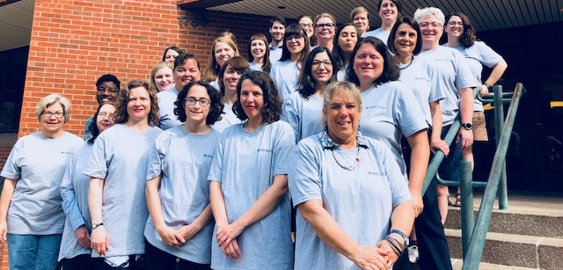
Thank You and Congrats 2021 RTI Fellows!
Notes:
We want to thank the 2021 class of RTI Fellows for participating in these assessments!
their engagement and perseverance, and their willingness to share their perspectives, experiences, and ideas for the numerous assessments that we conducted!

Slide 30
Comments/Questions?
For additional information about the RTI:
RTI web site:
MLANET, under “Professional Development” link at top of page
http://www.mlanet.org/p/cm/ld/fid=1333
Today’s presentation (details):
https://www.mlanet.org/p/cm/ld/fid=1460
Contact Us:
Susan Lessick (slessick@uci.edu)
Jodi Philbrick (Jodi.Philbrick@unt.edu)
Emily Vardell (evardell@emporia.edu)
Ana Cleveland (Ana.Cleveland@unt.edu)
This project was made possible in part by the Institute of Museum and Library Services (RE-246568-OLS-20).
Notes:
The RTI website is the central place where we highlight the work of the Institute and the research activities of the Fellows.
More detailed information about the data I presented today will be on RTI Dissemination and Impact page.
Questions?

