Slide 1
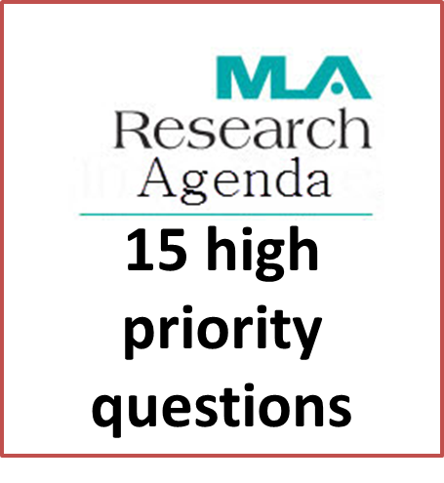
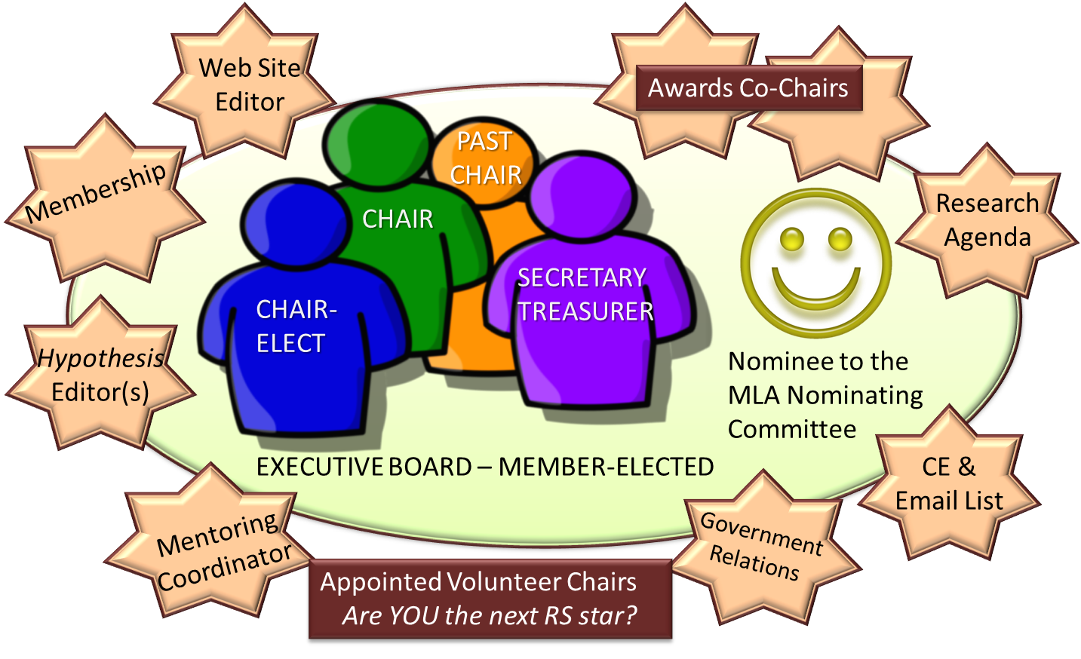
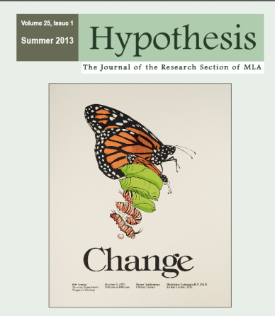
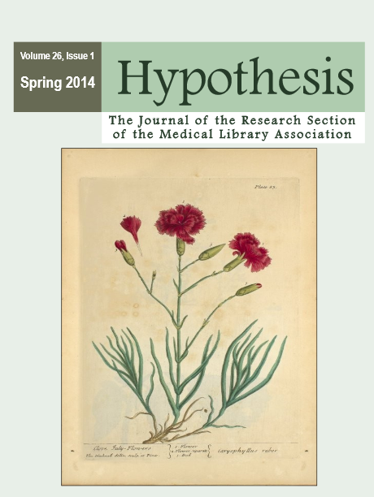
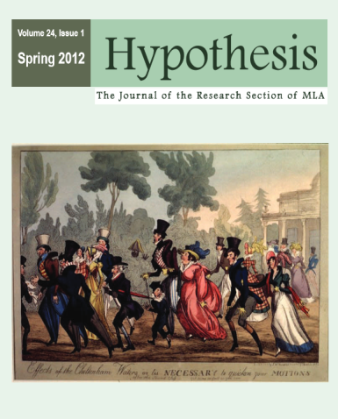
Engage and Promote Research in Health Sciences
History
Awards Program
MLA Research Agenda
Mentoring
1
2
3
4
12
5
6
7
8
9
10
11
13
14
15
Purpose: To promote the importance of research and assessment to improving library practice and patient care, and to enhance the research knowledge and skills of MLA members.
Purpose:
Recognize high-quality research papers and posters at MLA.
Motivate librarians to engage in research activities.
Process:
Volunteer judges evaluate MLA Annual Meeting research papers and posters.
Cash awards presented for best papers and posters; best research presented by a hospital librarian may also be awarded.
Examples of the
15 questions:
Is there quantifiable evidence that the presence of a medical librarian improves patient outcomes?
What is the role of medical librarians in improving health literacy rates among the public?
Are you interested in conducting research with others or have questions about the process?
Do you have prior research experience and want to share your knowledge while earning AHIP points?
If so, you should consider Research Mentorship!
1978
Ad hoc Committee on MLA’s role in library research
1982
Library Research Section - Provisional status
1987
1st Issue
of Hypothesis
1998
Launched awards for Best MLA Annual Meeting Presentations
Mentorship is a rewarding experience that benefits both participants.
Mentors give back to the profession and mentees benefit from experienced guidance in their research journey.
Research mentorships may focus on any of several research expertise areas listed in the MLA Membership Directory.
1980
Research & Evaluation Committee becomes Standing Committee
1983
First election
of officers!
1996
Name changed to Research Section
2013 - Present
Over 250 members and growing strong!!
Systematic Review Teams: formed in 2013 to determine what research had already been done on these 15 questions
Benefits
Systematic Teams
Co-authoring a paper
Co-authoring a poster
Getting hands on research practice
Meeting potential research mentors
Meeting other research- orientated librarians
Learning the systematic review process
Benefits: Individuals interested in joining the teams had the opportunities and benefits of:
Award for Best Biennial JMLA Research Paper
Become a Mentor: To become a research mentor, update your MLA Membership Directory contact information to show your area(s) of research expertise.
Find a Mentor: To find a research mentor, look for the research area closest to your interests in the MLA Membership Directory.
Purpose:
Award recognizes the best high-quality peer-reviewed research paper by an MLA member author published in the two previous years in the JMLA.
Winner receives cash award sponsored by MLA Research Section.
Inaugural award in 2014. Award will be presented every other year.
Best Biennial
JMLA Research Paper
EXPAND your network with colleagues actively building and applying research skills.
DISCOVER research you can use–read Hypothesis, attend Section programming, and learn from award-winning studies evaluated by your peers.
ENHANCE your research toolkit—use the Section’s Survey Monkey subscription for research.
CONNECT with potential collaborators or a research mentor to act on your ideas!
ENRICH your career and the profession through section leadership while earning points for the Academy of Health Information Professional.
PRODUCE or contribute to health sciences and library and information science knowledge.
SPEAK your thoughts through surveys, feedback, and advocacy for research funding.
Leadership Opportunities
Hypothesis: Official RS Journal
Be Informed | Inform Others
Open Access | Indexed in CINAHL
Outcomes
Hypothesis aims to:
Promote innovation and learning in our community.
Provide a platform for mentoring and grant-writing discussions.
Encourage the use of evidence to inform decisions in our organizations.
Supply objective evaluations of software and other resources.
Foster the sharing of research and new ideas among all LIS colleagues.
Stimulate participation in our culture of inquiry.
Advance the practice of research and evaluation in our community.
Acknowledgements
Kristine Alpi, Tara Brigham, Gisela Butera, Lori Fitterling,
Angela Hardi, Erla P. Heyns, Susan Lessick, Elisabeth Marrapodi, Emily Mazure, Debra Revere, Jennifer Staley, Donghua Tao,
For image references see:
http://research.mlanet.org/wp/poster-references/
Notes:
http://pixabay.com/en/award-ribbon-rosette-blue-161090/

