Slide 1
RESEARCH TRAINING INSTITUTE
2022 In-Person Poster Presentations
Host: Susan Lessick, AHIP, FMLA, University of California, Irvine (RTI Project Director)
Moderator: Emily Vardell, PhD, AHIP, Emporia State University (RTI Faculty)
Presenters:
Jess Callaway, AHIP, Shepherd Center
Amy Corder, Tulane University
Andrea Dater, Emporia State University
Jennifer DeBerg, University of Iowa
Andy Hickner, Weill Cornell Medicine
Toni Hoberecht, AHIP, University of Oklahoma
Niki Kirkpatrick, AHIP, University of Tennessee
Valerie Lookingbill, University of So Carolina-Columbia
Michele Mason-Coles, Walter Reed National Militry Medical Center
Molly Montgomery, Idaho College of Osteopathic Medicine
Laura Murray, AHIP, University of South Florida
Erin Reardon, AHIP, University of Minnesota
RTI website: https://www.mlanet.org/p/cm/ld/fid=1333
Twitter: @RTIatMLA

Slide 5
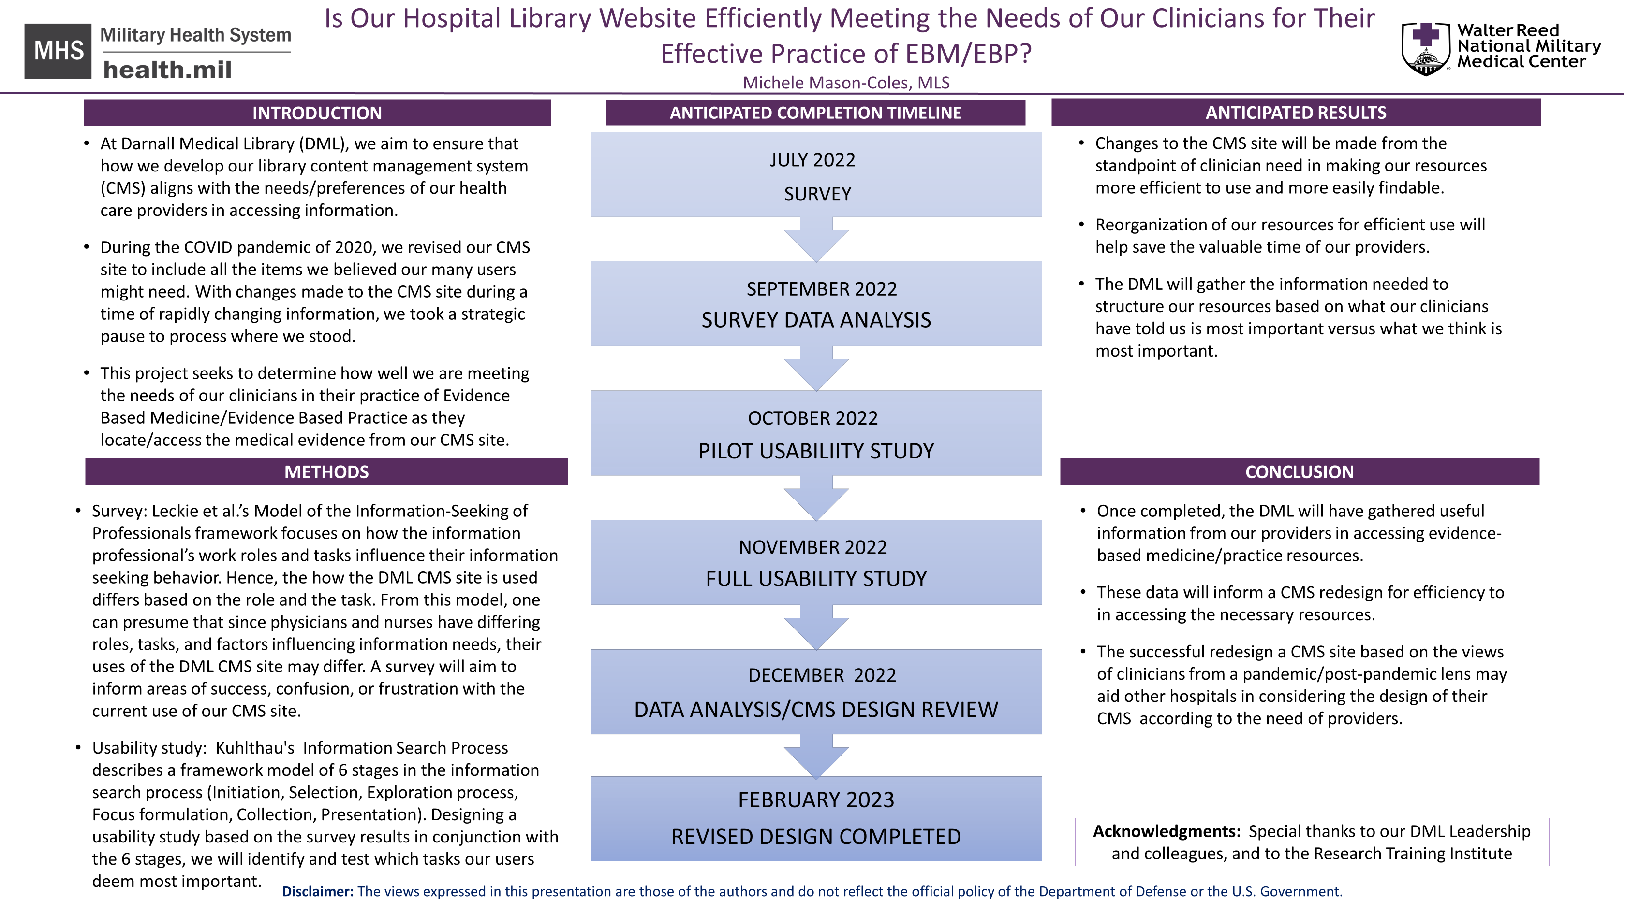

Slide 18
Julia Stumpff | The scholarly activity of GME trainees: Early stages of a research project that analyses publication patterns.
Niki Kirkpatrick | Forging New Ground - A Discussion of Virtual Anatomy Table Implementation in Libraries.
Michele Mason-Coles | Is our hospital library website efficiently meeting the needs of our clinicians for their effective practice of EBM/EBP?
Molly Montgomery | Osteopathic Medical Students Attitudes Towards Research: A Mixed-Methods Study
Toni Hoberecht | Technical Services Librarians and MLA: Attitudes and Perceptions
Andrea Dater | Breaking Down the IRB Approval: A Content Analysis of RTI Participants' Institutional Review Board Approval Documents
Andy Hickner | What do systematic searchers need from search interfaces?
Jess Callaway | The paradox of disinformation in hospital libraries
Erin Reardon | Tenure, Promotion, Appointment, Oh My! The Processes of Academic Health Sciences Libraries
Jennifer DeBerg | Exploring DNP student information literacy competence for evidence-based practice
Laura Murray | Examining the Role of the Health Science Librarian in Supporting LGBTQ+ Information Literacy among Health Science Students, Residents, Fellows, or Faculty
Amy Corder | Knowledge of the systematic review process among health sciences faculty
Valerie Lookingbill | Stigmatized mental health content on TikTok: A qualitative content analysis

