Slide 1
RESEARCH TRAINING INSTITUTE
2021 MLA Research Training Institute Fellows Ignite Session
Moderators
Susan Lessick, MA, MLS, AHIP, FMLA, University of California, Irvine (RTI Project Director)
Jodi Philbrick, MSLS, PhD, AHIP, University of North Texas (RTI Faculty)
Emily Vardell, MLS, PHD, Emporia State University (RTI Faculty)
Panelists
Hilary Jasmin, MSIS, University of Tennessee Health Science Center (RTI Peer Coach)
Laura Menard, MLS, Indiana University School of Medicine – Indianapolis (RTI Peer Coach)
Robin O’Hanlon, MIS, Memorial Sloan Kettering Cancer Center (RTI Peer Coach)
MLA ‘21 vConference, May 2021 https://twitter.com/RTIatMLA
Notes:
Welcome and thank you all for coming to the 2021 RTI Ignite Session as part of this year’s MLA vConference. 🙏
I am Susan Lessick, RTI Project Director, and I am joined today by our two lead RTI faculty (Jodi Philbrick and Emily Vardell) AND three RTI peer coaches (Laura Menard, Hilary Jasmin, and Robin O’Hanlon). We are also joined by many RTI Fellows who will be presenting their research projects that they are developing at the Institute.
------
Next slide

Slide 2
Today’s Agenda
RTI Overview, Sponsors & Fellow Presenters
(12:10-12:40) Ignite Session 1 (Out of Gate) - Searching literature + Developing Instrument + IRB
Presentations
Panel Discussion
(12:40-1:10) Ignite Session 2 (Rounding the Corner) - Collecting Data
Presentations
Panel Discussion
(1:10-1:50) Ignite Session 3 (Crossing the Finish Line) - Analyzing Data + Writing for Publication
Presentations
Panel Discussion
Questions from audience
Adjourn (2:00 pm, Central Time)
Notes:
At today’s session I will provide a brief overview of the program and recognize all those who have made the program possible and so successful.
We will then have three ignite sessions consisting of brief talks by our RTI Fellow presenters followed by a panel discussion.
After these sessions, there will be an opportunity for our presenters to answer questions from the audience.
Then time permitting, we will have an open Q & A period for everyone.

Slide 3
RTI Overview
RTI Goals & Learning Model
Evidence shows RTI learning model is sound and effective
RTI Assessment Findings:
https://www.mlanet.org/p/cm/ld/fid=1634
Research Works Completed by 2018 and 2019 RTI Fellows:
https://www.mlanet.org/page/rti-fellows-scholarly-contributions
On Demand Paper at MLA ‘21T vConference:
Transforming Practice through an Innovative Training Model, video chat session, Wed, May 26, 2:50pm (CT)
RTI’s exciting future is quickly becoming a reality!
Notes:
WHAT EXACTLY IS THE RTI PROGRAM?
The goals of the RTI are to increase research competencies; increase the quality, quantity, and dissemination of librarian-led research; and build research capacity among Health Sciences librarians to contribute to health and library improvements throughout the country.
We aspire to do all that…by offering:
A unique immersive training experience in advanced research design
Providing mentoring and monitoring as participants complete a research project
Providing an online community of practice FOR DISCUSSIONS
A capstone presentation at MLA annual meetings – that is what is taking place right now – the annual presentation of fellows’ research projects.
HAVE WE BEEN SUCCESSFUL?
All of our assessment findings demonstrate that the program has significantly increased the research skills and confidence of our participants! Data from the first two cohorts show that an overwhelming majority of participants complete their research projects. So far, our 2018 and 2019 fellows have generated 12 research publications in peer reviewed journals. Fellows also report many institutional impacts of RTI training – with the most frequent being, forming new internal and external research partnerships.
We share our results publicly and use them for program improvement. The link to our findings is on the slide. I also have a link to an amazing list of research publications authored or co-authored by our 2018 and 2019 Fellows since they completed our program. Good work RTI researchers!
For more information about our assessment findings - we have a paper later in the conference that does a deep dive into our results, so please join us for our video chat session.
OUR RTI LEARNING MODEL CONTINUES TO EVOLVE AND GET BETTER!
We were awarded a second IMLS grant to create an ONLINE program (new online program starts in June).
This RTI Online program has many new features:
We have expanded the curriculum and increased the number of participants per institute;
We are offering instruction on research dissemination using social media and we are building an active Twitter presence for disseminating RTI and librarian-led research news;
We are piloting a new peer coaching program with 5 peer coaches who are former RTI fellows;
We are also including for the first time ever, 6 LIS Master’s students from the University of North Texas and Emporia State University.
The new grant and learning model provides an opportunity to embrace our past success while building an even better future for our program and the health sciences librarians we educate.
NEXT SLIDE

Slide 4
Support from Sponsors
Scholarships
2018
Donations: $9,660; 11 Sections & 3 Chapters
19 scholarships: 1 participant declined ($2130)
4 full (IMLS & AAHSL)
14 partial (IMLS, Sect & Chapter)
2019
Donations: $22,900; 12 Sections & 6 Chapters
19 scholarships; 1 participant declined ($2300)
4 full (IMLS & AAHSL)
6 full (Section & Chapter)
9 partial (IMLS, Section & Chapter)
2020
Donations: $6,100: 7 Chapters
17 scholarships; 3 non-members ($1525)
2 (AAHSL)
5 (Chapter)
10 (MLA operations & individual donors)
2021
Donations: $13,545: MLA Fellows and 4 Chapters
26 scholarships; all participants funded ($750)
4 (AAHSL)
5 (MLA Fellows)
4 (Chapter)
13 (IMLS)
Support From Grant & Academic Partners
IMLS Grant funds multiple scholarships for librarians (2018-2019, 2021-2022)
Association of Academic Health Sciences Libraries (AAHSL) (2018 – 2022)
University of Illinois at Chicago, Library of the Health Sciences-Chicago (2018-2019)
University of North Texas (UNT) Master of Science in Information Science program (2021 - 2022)
Emporia State University (ESU), School of Library and Information Management program. (2021-2022)
Support from MLA Communities (recent 2021 sponsors)
MLA Fellows
MLA Chapters
NY/NJ Chapter
South Central
Midcontinental Chapter
PNW
Philadelpia Chapter
Notes:
We could not have offered a quality RTI program without the help of our sponsors and program staff. 🙏
The RTI program has received lots of support from our IMLS grant and academic partners, including AAHSL scholarships, since 2018. In the past we have also received scholarship donations from MLA Sections, MLA operations, and individual donations. Currently scholarship support has been generously provided by MLA Chapters and the MLA Fellows. This scholarship support is deeply appreciated by the RTI Fellows!
---------------------------
NEXT SLIDE

Slide 5
RTI Program Staff, 2018-2022
Faculty
Katheryn Akers, Biomedical Research and Data Specialist, Shiffman Medical Library, Wayne State University, Detroit, MI (Instructor, 2020-2022)
Sally Gore, Manager of Research and Scholarly Communication Services, Lamar Soutter Library, University of Massachusetts Medical School –Worcester (Instructor, 2018-2019)
Karen Gutzman, Head of Research Assessment and Communications, Galter Health Sciences Library & Learning Center at Northwestern University (Instructor & Social Media Coordinator, 2021-2022)
Lorie Kloda, AHIP, Associate University Librarian, Concordia University, Montreal, QC, Canada (Co-Lead instructor, 2018-2020)
Mark MacEachern, Informationist, Taubman Health Sciences Library, University of Michigan–Ann Arbor (Instructor, 2018-2022)
Jodi L. Philbrick, AHIP, Senior Lecturer, Department of Information Science, University of North Texas–Denton (Co-Lead instructor, 2018-2022)
Emily Vardell, Assistant Professor, School of Library and Information Management, Emporia State University, Emporia, KS (Instructor, 2018-2020; Co-Lead Instructor, 2021-2022)
Academic Liaison (2021-2022)
Ana Cleveland, PhD, AHIP, FMLA, Regents Professor, Sarah Law Kennerly Endowed Professor, and Director of the Health Informatics Program, University of North Texas, Denton, TX
Peer Coaches (2021-2022)
Hilary M. Jasmin, Research and Learning Services Librarian, Health Sciences Library of the University of Tennessee Health Science Center, Memphis.
Laura Menard, Assistant Director for Medical Education and Access Services, Ruth Lilly Medical Library, Indianapolis, IN.
Robin O’Hanlon, Associate Librarian for User Services, Memorial Sloan Kettering Cancer Center Library, New York City.
Natasha Williams, AHIP, User Services Librarian, Harriet F. Ginsburg Health Sciences Library, University of Central Florida (UCF) –Orlando.
Ying Zhong, Associate Librarian, Walter W. Stern Library, California State University, Bakersfield.
RTI Leadership Team (2018-2022)
Susan Lessick, AHIP, FMLA, Librarian Emerita/RTI Project Director, University of California, Irvine
Mary Langman, MLA Director of Information Issues & Policy
Barry Grant, MLA Director of Education
Debra Cavanaugh, MLA Director of Professional Development
Notes:
We also have a dedicated RTI program staff who are the heart of RTI’s excellence!
I’m so thankful for our outstanding faculty of research experts for the past 3 years; we have been fortunate to add team members this year with new areas of expertise, including a digital dissemination coordinator, an academic liaison, and our talented peer coaches; and we have a very hardworking leadership team!
Thank you all!
------------------------
NEXT SLIDE

Slide 6
2018 RTI Fellows
Janene Batten, Harvey Cushing/John Hay Whitney Medical Library, Yale University, New Haven, CT
Helen-Ann Brown Epstein, AHIP, FMLA, Health Sciences Library, Virtua, Mt Laurel, NJ
Amelia Brunskill, Library, University of Illinois–Chicago
Kathy Davies, Greenblatt Library, Augusta University, August, GA
Carrie Grinstead, AHIP, Library, Providence St. Joseph Health, Burbank, CA
Margaret Hoogland, AHIP, Mulford Health Sciences Library, University of Toledo, Toledo, OH
Melissa K. Kahili-HeedeHealth Sciences Library, John A. Burns School of Medicine, University of Hawaii–Manoa, Honolulu, HI
Liz Kellermeyer, Tucker Medical Library, National Jewish Health, Denver, CO
Mellanye J. Lackey, AHIP, Health Sciences Library, University of Nevada, Las Vegas
Alicia Lillich, Dykes Library, University of Kansas Medical Center–Kansas City
Elisabeth Nylander, University Library, Jönköping University, Jönköping, Sweden
Robin O’Hanlon, Library, Memorial Sloan Kettering Cancer Center Library, New York, NY
Ariel FitzGerald Pomputius, Health Science Center Library, University of Florida–Gainesville
Rebecca Roth, Medical Library, Herbert Wertheim College of Medicine, Florida International University–Miami
Elizabeth Suelzer, MCW Libraries, Medical College of Wisconsin–Milwaukee
Holly Jean Thompson, Wilson Dental Library, University of Southern California
Whitney A. Townsend, Taubman Health Sciences Library, University of Michigan–Ann Arbor
Mary White, AHIP, Health Sciences Library, University of North Carolina–Chapel Hill
Natasha Williams, AHIP, Harriet F. Ginsburg Health Sciences Library, University of Central Florida–Orlando
Laura Zeigen, AHIP, OHSU Library, Oregon Health & Science University–Portland
Notes:
Last but most important of all…we want to recognize our RTI Fellows – here is a list of all the 2018 RTI Fellows – I’ve highlighted those Fellows who will be presenting today along with our peer coaches!
--------------------------
NEXT SLIDE

Slide 7
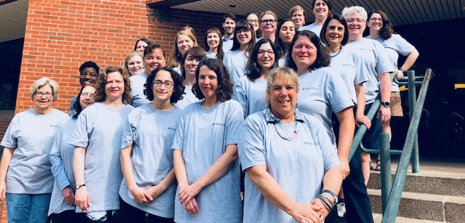
Thank You 2018 RTI Fellows!
Notes:
Here is our official 2018 RTI fellows photo! In our grey RTI T-shirts on the front steps of the Health Sciences Library on the UIC campus in Chicago!

Slide 8
2019 RTI Fellows
Karin Bennedsen, AHIP, Library, Georgia Highlands College, Atlanta, GA
John Bourgeois, AHIP, John P. Isché Library, Louisiana State University Health Sciences Center–New Orleans
Mary Pat Harnegie, AHIP, South Pointe Medical Library, Cleveland Clinic, Cleveland, OH
Karen Heskett, Biomedical Library, University of California–San Diego, La Jolla, CA
Rachel Hinrichs, AHIP, University Library, Indiana University-Purdue University–Indianapolis
Hilary Jasmin, Health Sciences Library, University of Tennessee Health Science Center–Memphis
Ellen M. Justice, AHIP, Clinical and Research Librarian, UNC Health Sciences at MAHEC, Asheville, NC
Sa'ad Laws, Weill Cornell Medicine-Qatar, Doha, Qatar
Andrea Lynch, Lee Graff Medical and Scientific Library, City of Hope, Duarte, CA
Sandra McCarthy, Bailey Library, Washtenaw Community College, Ann Arbor, MI
Laura Menard, Ruth Lilly Medical Library, Indiana University–Indianapolis
Jolene M. Miller, AHIP, Mulford Health Science Library, University of Toledo, Toledo, OH
Tanisha N. Mills, AHIP, Northeast Georgia Health System–Gainesville
Katherine Orze, Health Sciences Library, Loyola University Chicago, Chicago, IL
Nicole Pettenati, Public Health Accreditation Board, Alexandria, VA
Helenmary Sheridan, Health Sciences Library System, University of Pittsburgh, Pittsburgh, PA
Stephanie M. Shippey, AHIP, Preston Smith Library of the Health Sciences, Texas Tech University Health Sciences Center–Lubbock
Jennifer Westrick, AHIP, Library, Rush University Medical Center, Chicago, IL
Roby Woods, AHIP, NNLM, MidContinental Region.
Ying Zhong, Walter W. Stiern Library, California State University–Bakersfield
Notes:
Here is a list of the 2019 RTI Fellows…Today’s presenters and peer coaches are highlighted in bold type…
--------------------------
NEXT SLIDE

Slide 9
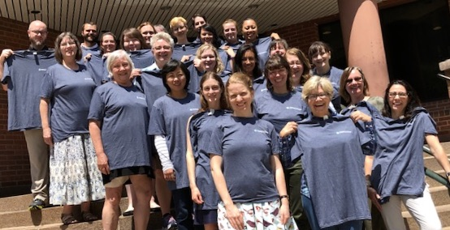
Thank You 2019 RTI Fellows!
Notes:
Here is the official 2019 RTI fellows’ photo! In our blue RTI t-shirts on the front steps of the Health Sciences Library on the UIC campus in Chicago!

Slide 10
2020 RTI Fellows
Gary Atwood, Dana Medical Library, University of Vermont–Burlington
Ana Corral, Virginia Tech Libraries, Virginia Polytechnic & State University–Blacksburg
Daina Dickman, AHIP, University Library, Sacramento State University, Sacramento, CA
Anna Ferri, Library, Roseman University of Health Sciences, Henderson, NV
Lynn Kysh, Health Sciences Library, Children’s Hospital Los Angeles, Los Angeles, CA
Stefanie Lapka, Health Sciences Libraries, University of Houston, Houston, TX
Michele L. Mason-Coles, Darnall Medical Library, Walter Reed National Military Medical Center, Bethesda, MD
Caitlin Meyer, Cushing Whitney Medical Library, Yale University, New Haven, CT
Rebecca Anne Morin, Hirsh Health Sciences Library, Tufts University, Boston, MA
Annie Nickum, AHIP, Library of the Health Sciences, University of Illinois–Chicago
Christi Piper, Strauss Health Sciences Library, University of Colorado Anschutz Medical Campus–Aurora
Stacy Posillico, Eastern Region Hospitals Libraries, Northwell Health, Hempstead, NY
Kearin Reid, AHIP, Library, College of American Pathologists, Northfield, IL
Mary Roby, Laupus Health Sciences Library, East Carolina University, Greenville, NC
Margarita Carrillo Shawcross, James A. Michener Library, University of Northern Colorado–Greeley
Melanie E. Sorsby, Medical Library, Covenant Health System and School of Nursing, Lubbock, TX
Sam Watson, National Network of Libraries of Medicine, Greater Midwest Region, Hardin Library, University of Iowa–Iowa City.
Aidy Weeks, AHIP, Health Sciences Library, University of Nevada–Las Vegas
Kristin Whitman, Health Sciences Library-Meridian, Idaho State University–Pocatello
Stacy Winchester, Thomas Cooper Library, University of South Carolina–Columbia
Notes:
Here is a list of the 2020 RTI Fellows – those in highlights are presenting their research work today.
--------------------------
NEXT SLIDE

Slide 11
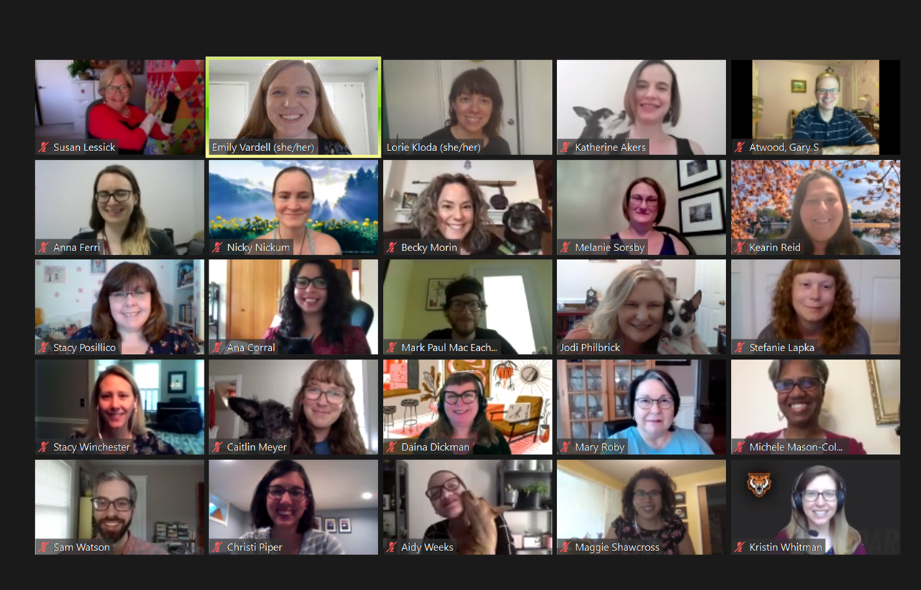
Thank You 2020 RTI Fellows!
Notes:
Here is our official 2020 RTI fellows photo! … in the zoom environment with our pets!
------------------------
I will now turn the session over to Emily who will introduce and facilitate the fellows’ presentations. We hope you enjoy the session and that it inspires your own research efforts!
Emily…

