Slide 1
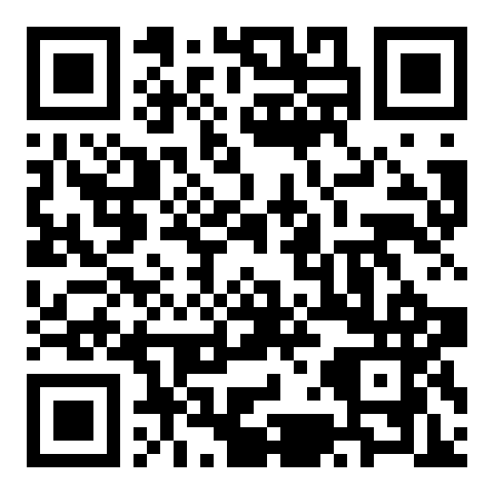
The expectations, priorities, and preferences of students with disabilities when seeking accessibility information on academic library websites Amelia Brunskill, University of Illinois at Chicago
The situation:
It’s common for academic libraries to have a webpage, or multiple webpages, devoted to describing the resources, services, and facilities of the library for users with disabilities. However, these pages vary considerably and there are no clear standards for these pages nor literature on the preferences of users with disabilities for this content.
The question:
What are the expectations, priorities, and preferences for students with disabilities when they try to locate and use these library pages on accessibility?
Challenges:
Literature review: Hard to distinguish webpage accessibility vs. information about accessibility on webpages
How prepared for different needs in the interview should I be?
Locating a good option for remote interviewing
Recruitment:
In person meetings with campus organizations to get their input and buy-in for the project resulted in them including a call for participants in their newsletters.
Print flyers were posted around campus
I included information on this study in my regular news email to students in my liaison college
Participants: Twelve students, including undergraduates and graduate students, participated. They divulged a variety of disabilities, including dyslexia, ADHD, brain injury, autism, mobility issues, chronic pain, nerve damage, vision impairment, depression, anxiety, and chemical sensitivity.
Methods:
Semi-structured interviews. Consisted of a number of open and closed questions, also involved them ranking some categories and selecting five top priorities in terms of content to include on a webpage of information about accessibility.
Preliminary findings:
Students desired information on…
Sensory information (sound levels, lighting…)
Furniture
Physical layout of building
Some stated preferences included:
Contact information for named individuals
Language that makes them feel like they aren’t imposing
Other issues that emerged:
Common terms—disability, accommodation, accessible—have different connotations to different people
Students with invisible disabilities can find locating information relevant to them difficult
Clear organization is important, but assumptions about who would use what services can be incorrect or incomplete
Acknowledgements:
Many thanks to the MLA Research Training Institute for its training, support and encouragement to carry out this research.
“I would definitely want to know what the physical space is going to be like and what I'm going to encounter when I get there…this is something that people often push back a lot--they're like, that's a lot of detail that you're asking for, and I'm like, without that detail, I'm not coming.”
“I wasn't diagnosed until I was transitioning into graduate school, so I'm very new to services that are provided. So I probably would expect that it would exist, but I have never searched out for it.”
“I would hope it would be easy to find and thorough to make it seem like it wasn't just tacked on to the website as an afterthought”
“maybe because my disability [is] more invisible, so it's not really something that I'd be like, oh, is this ‘accessible’ to you?”
“I mean inclusivity-- not forgetting about people with other types of disabilities besides physical disabilities or hearing or…sight difficulties.”

Slide 2
Librarians as Teachers: Researching an Educational Knowledge Gap
Kathy Davies, Interim Director of Libraries
Challenges
Increasing instruction demand
Limited training in adult learning
Multiple teaching steps
Opportunities to improve skills
Education Theory @ Augusta University
Constructivism (Jean Piaget)
LCME standards
Experiential learning
Lessons Learned
Support is critical
Planning time is key
Flexible design for research proposals
Teaching Cycle
Focus
Using varied Instructional Methods
Assessment of teaching performance
Strategies
Workshops
In Progress
Research projects
Peer Review Form
Discussions
Committees
Lit review
Teaching guides
Future
Analyze Audience
Content Planning
Methodology
Learning Assessment
Reflection & Revision
Investigate other gaps
Focus on publication
Selected Resources
Educational Learning Theories (GALIEO Open Texts)
Using the ADDIE Model in Designing Library Instruction
(Reinbold)
Thanks to MLA Research Training Institute for its training, support
and encouragement to carry out this research.

Slide 3
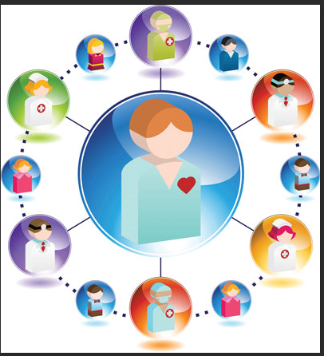
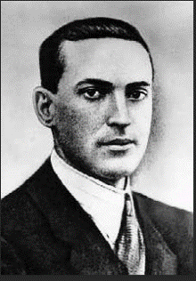
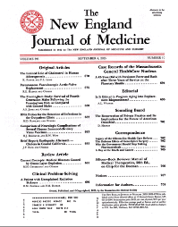
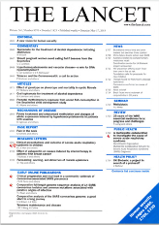
Online Journal Club Format Conducive to an Interprofessional Team
Helen-Ann Brown Epstein MLS,MS,AHIP,FMLA, Informationist, Virtua, Mt. Laurel, NJ
Theoretical Framework
Study Plan
Get IRB approval
Invite participants
1st inperson meeting
COLLES
Expectations
Logistics
Journal Clubs online:
online webinar
posting to discussion
posting with webinar
Lev Vygstoky ( 1896-1934 )
Social Constructivism
Constructivist On-Line Learning
Environment Survey (COLLES)
Survey to measure perceptions of:
Professional Relevance Interactivity
Reflective Thinking Cognitive Demand
Affective Support Interpret of Meaning
*Collaboration to co-construct new
understanding
*Social interaction…a synergy of wisdom
*Social interaction constructs innovative
ways of thinking
*Learners see themselves as active
constructors of knowledge
Invitees to the Study
Nurse Physician
Hospital Administrator
Outcomes Manager
Infection Control
Nurse Resident
Medical Resident
2nd inperson meeting
COLLES
Expectations met
Debriefing
Selected References
1. Ethics Behav 2018;28(5):393-410
2. Med Educ 2009;43:923-5
3. In: 9th Annual Teaching Learn Forum
Feb 2-4 2000, Perth, W.A
4. Curr Pharm Teach Learn 2018;10(5):662-8
5. J Interprof Care 2004;18(3):263-7

Slide 4
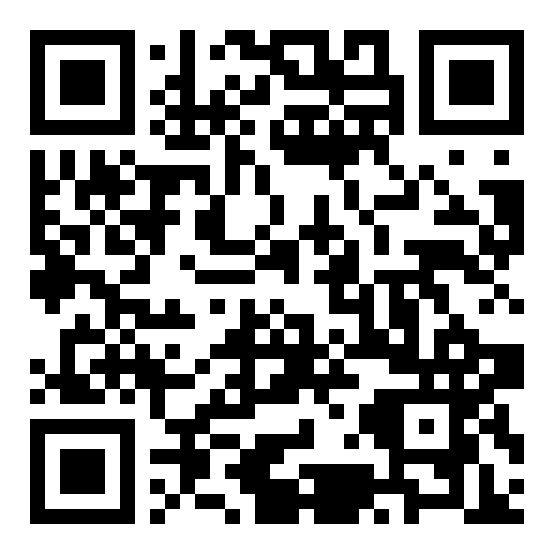
Nurses educate patients and families. Nurses use resources from the Internet to provide education. (Pretty much) everyone uses the Internet to look for health information (1). But… little is known about nurses’ actual experiences using online educational resources and discussing them with patients
Non-Cognitive Predictors of Student Success: A Predictive Validity Comparison Between Domestic and International Students
Non-Cognitive Predictors of Student Success: A Predictive Validity Comparison Between Domestic and International Students
Nurses’ experiences and perceptions of using online resources for patient and family education: a qualitative interview study
SELECTED LITERATURE
2005 study of oncology nurses identified
a division between nurses who “were insulted when patients challenged their expertise based on information gleaned from the Internet,” and nurses who viewed Internet health information as a catalyst for change and a facilitator of patient-provider relationships (2)
nurses’ function as “knowledge consultants,” facilitating patients’ searches, evaluating information needs, individualizing information, and correcting misinformation (2)
2011 observational study of nurses in practice found that
nurses had very little time to search for information (3)
hospital policy often required the use of particular educational materials (3)
lack of knowledge and previous negative experiences hampered use of online resources (3)
PRELIMINARY RESULTS
The study has received IRB approval, and we are now recruiting and interviewing participants. Interviews will continue until thematic saturation has been reached.
Interviews so far suggest that
Division identified by Dickerson et al. remains, nearly fifteen years later
Nurses worry about inaccurate or inappropriate material found online by patients and families
Google, disease-specific websites, and organizationally mandated material (Krames online) are common sources for patient education materials
Nurses use their own knowledge and experience, and reach out to colleagues, to educate patients
Carrie Grinstead, MLIS AHIP, Sarah Sumner, MSN RN OCN CHPN, Julius Shakari, MSN RN CNL, Martha Inofuentes, BSN-RN CMSN OCN
Study objectives
Gain in-depth understanding of nurses’ experiences using resources such as Krames Online, MedlinePlus, or other websites to educate patients and their families
Identify themes that can be used to design questionnaires and outreach education for nurses, managers, and administrators
METHODS
Recruit participants at Providence St. Joseph Medical Center in Burbank, CA
Conduct semi-structured interviews
Transcribe and code interviews as they are completed
Share coded transcripts with nurse co-investigators
Re-code transcripts incorporating feedback from nurses
Identify and synthesize major categories and themes
References | Acknowledgements
1. Fox S, Duggan M. Health Online 2013 [Internet]. Washington, DC: Pew Research Center; 2013 Jan 15 [cited 2019 Apr 22]. Available from: https://www.pewinternet.org/2013/01/15/health-online-2013/ | This project was made possible in part by the Institute of Museum and Library Services (RE-95-17-0025-17). The project received funding from the Medical Library Group of Southern California and Arizona. We thank the MLA Research Training Institute for its training, support and encouragement to carry out this research.
2. Dickerson SS, Boehmke M, Ogle C, Brown JK. Out of necessity: oncology nurses’ experiences integrating the Internet into practice. Oncol Nurs Forum. 2005 Mar 5;32(2):355-62.
3. Jones J, Schilling K, Pesut D. Barriers and benefits associated with nurses information seeking related to patient education needs on clinical nursing units. Open Nurs J. 2011;5:24-30.
Notes:
Notes:
In Powerpoint, click View > Guides
Keep text within gutter guides.
Author list: Don’t split names onto two lines (e.g., “Jimmy [break] Smith”). If that happens, use a new line, unless you need the space. Bold the first names of anybody who’s presenting in person.
Intro/methods/result: Do not drop below font size 28, but if you have extra space, jack up the font size until the space is full.
Do not use color in the sidebars except in graphs/figures. It’ll pull attention from the center and slow interpretation for passersby.

Slide 5
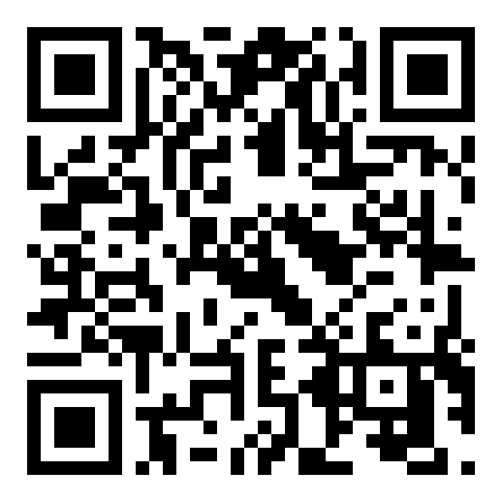
How Medical Students Discover and Use Medical Information Tools
Margaret A. Hoogland, MLS, AHIP
Mulford Health Sciences Library
The University of Toledo
Librarians, who adapt sessions and conversations with premedical students, can impact how students use medical information tools for
the remainder of medical school.
Results
Of the 525 students who received an invitation to participate, 122 completed the survey and 18 participated in a discussion. Preclinical students primarily use UptoDate and Epocrates. By contrast, Clinical students use Google, Google Scholar, and UptoDate. During the discussion sessions, most students mention UptoDate first but mention using other medical information tools. Out of 18 students, two students or 11% consulted UptoDate exclusively in a clinical setting.
Objective
Many studies discuss the use of medical information tools by clinical medical students (i.e. third-and-fourth year students). Few studies examine how preclinical students (i.e. first-and-second year students) discover and use medical information tools. By understanding the needs of preclinical medical students, medical librarians can adjust the content and delivery of information in their training sessions. The purpose of this study is to better understand the medical information needs of preclinical students.
Methods
Medical students received and email containing the study description, link to an online survey, and an opportunity to answer additional questions about medical information tools. Discussion participants got an Amazon or Starbucks gift card. Survey participants received no compensation.
Acknowledgements
I thank the MLA Research Training Institute for its training, support and
encouragement to carry out this research. This project was made possible in part by the Institute of Museum and Library Services (RE-95-17-0025-17).

Slide 9
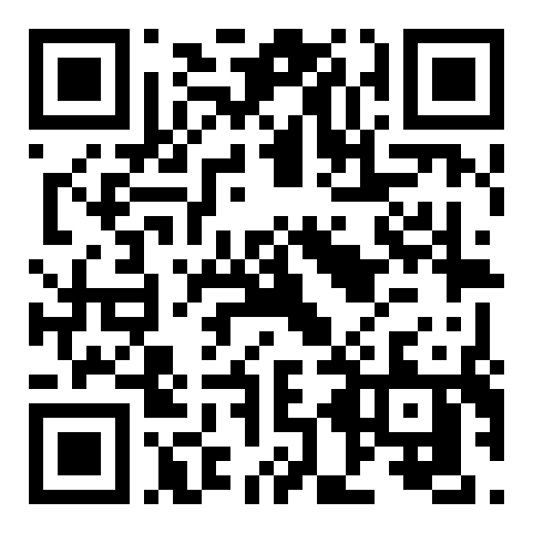
PhD students in the health sciences are underrepresented in the literature on information literacy (IL). So, we asked our PhD students and their advisors about IL during doctoral studies and how librarians can help.
Non-Cognitive Predictors of Student Success: A Predictive Validity Comparison Between Domestic and International Students
Non-Cognitive Predictors of Student Success: A Predictive Validity Comparison Between Domestic and International Students
How can we help? Information literacies of PhD students in the health sciences
RESULTS
Our scoping review revealed that many studies fail to treat doctoral studies as a unique process. The result is that PhD students in the health sciences are underrepresented as a distinct group within the recent literature. We are currently performing a critical analysis of the few studies that focus specifically on health science PhD students. Later this year, we expect to present a discussion of these results as well as the findings from interviews at our own health sciences research school.
CONCLUSION
This project highlights the need for more primary research on the information literacies of PhD students in the health sciences.
REFERENCES
1. Arksey H, O'Malley L. Scoping studies: towards a methodological framework. International Journal of Social Research Methodology. 2005 2005/02/01;8(1):19-32. https://doi.org/10.1080/1364557032000119616.
2. Guba EG, Lincoln YS. Fourth generation evaluation. Newbury Park, Calif: Sage; 1989. ISBN 0-8039-3235-9.
Elisabeth Nylander Margareta Hjort
INTRODUCTION
Doctoral studies offer a unique phase in the development and legitimization of researchers, in which PhD students shift from the consumption to the production of knowledge. If librarians are to support this process in an evidence-based manner, it is essential to understand the distinct practices of this population. While literature exists concerning the information behavior of graduate students and researchers, there is little work which focuses specifically on the information literacies of PhD students within the health sciences.
AIM
The aim of this project was: 1) to establish the depth and breadth of evidence describing the information literacies of PhD students within the health sciences, and 2) to explore how Jönköping University Library can support the PhD students and their supervisors at the Research School of Health and Welfare.
METHOD
The project aims suggested a mixed method approach. In order to examine the concept of information literacies among PhD students, a scoping review was performed [1]. General trends within the literature were mapped based on the extraction of the following data: geographic location, population, academic discipline, and method of investigation. To better understand the information practices at our health sciences research school, we interviewed both PhD students and their supervisors. These open-ended interviews were conducted and analyzed according to a hermeneutic dialectic process [2], resulting in synthesized constructions of the study participants’ experiences.
ACKNOWLEDGEMENTS This project was made possible in part by the Institute of Museum and Library Services (RE-95-17-0025-17). We also thank the MLA Research Training Institute for its training, support and encouragement to carry out this research.
margareta.hjort@ju.se
elisabeth.nylander@ju.se

Slide 11
Understanding the Information Needs of an FIU Affiliated Psychiatry Medical Residents: A Case Study
Rebecca Roth, MS(LIS), Clinical Engagement Librarian, Herbert Wertheim College of Medicine, Florida International University, Miami, FL
OBJECTIVE: how well is the Florida International University’s Herbert Wertheim College of Medicine’s (FIU HWCOM) Medical Library meeting the research, reference, and instruction needs of the medical residents at one of its affiliated clinical sites?
SURVEY RESULTS continued…
Not knowing how/ not being able to use their FIU e-mail correlated with not knowing how/ not being able to use the Medical Library’s subscription resources.
Focus Group Results: themes that emerged from the focus group were as follows:
The original orientations the residents received when they entered their program had not been sufficient to explain the process of acquiring library access.
Many were unaware that their library access hinged upon having successfully communicated with the College of Medicine’s Human Resources Department.
Medical residents described that the process of troubleshooting their access was too confusing and time-consuming.
METHODS:
A brief, five-question survey
A subsequent 30 minute focus group
Ten out of fourteen possible residents participated. Two were fellows.
SURVEY RESULTS:
Medical residents were asked how often they used the library website, communicated with an FIU medical librarian, visited the FIU main campus, visited the Medical library on campus, and used their FIU e-mail/ credentials for other non-library purposes
Half of the medical residents had never communicated with a medical librarian, and six had never visited the medical library.
Two medical residents had never visited the FIU campus. Of those who had, only three visited campus regularly and two had never even visited.
Those who visited the campus regularly reported higher use of library services (both on and off campus).
Two Question Responses in Graph Form:
Conclusion: fortunately, these problems are primarily those of communication and are easily remedied.
By improving communication between the Medical Library, College of Medicine Human Resources Department, and Program Coordinators – three distinct groups that play a role in this process of granting affiliated medical residents access to the library– the Medical Library will be able focus more on the resources and services it provides instead of whether or not people are using them at all.

Slide 14
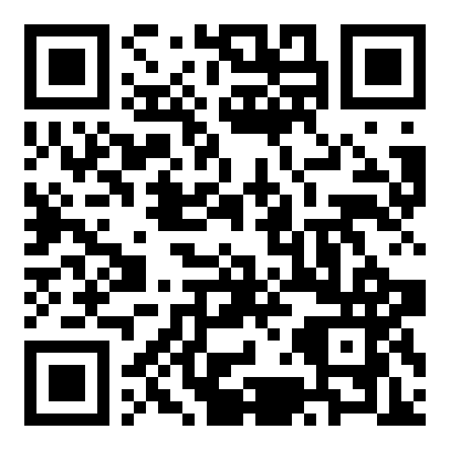
Similarities in personal librarian program implementation are present across all participating libraries. Ultimately, each program is uniquely structured to best meet the needs of its users.
Non-Cognitive Predictors of Student Success: A Predictive Validity Comparison Between Domestic and International Students
Trends Among Personal Librarian Programs in Medical and Academic Health Sciences Libraries
ACKNOWLEDGEMENTS
Thanks to the MLA Research Training Institute for its training, support and encouragement to carry out this research. Thank you to Sweta Chalise for providing advice regarding statistics. This project was made possible in part by the Institute of Museum and Library Services (RE-95-17-0025-17).
Natasha Williams, MLIS, AHIP
BACKGROUND
Personal librarian programs (PLPs) are an outreach model for delivering library information and instruction that assigns one librarian to a group of students as their “personal librarian”, with the aim of enhancing and personalizing students’ individual library experience. Much of the literature on this topic pertains to applications in undergraduate libraries within academic institutions. This study examines how PLPs are implemented within medical and academic health sciences libraries.
METHODS
A 26-item survey was developed in Qualtrics and sent to the following library email listservs: MEDLIB-L (1734 subscribers), AAHSL-ALL (350 subscribers), AACRL-HSIG (696 subscribers), and PSS-Lists (102 subscribers). Participants were also invited to contact the researcher if they were interested in participating in a follow-up interview. Survey responses were analyzed in Excel; incomplete survey sessions were excluded from analysis.
RESULTS
Of the 2,882 emails sent, 49 survey sessions were recorded, and a total of 38 survey sessions were completed (1.3% response rate). Of the 38 completed responses, 12 libraries reported that a PLP had been implemented at their institution (31.5%). Four questions provided operational information the researcher felt to be most useful to libraries exploring creating their own PLPs: “How many librarians participate in your personal librarian program”; “Approximately how many students are assigned to each of the library participants in your program”; “What types of students does your program serve”; “Please describe the services your personal librarian program offers to students”. Follow up interviews were not conducted due to lack of interest.
Take a picture to view the poster in the conference app!
1-5 (n=8)
6-10 (n=4)
# of Librarians involved
Types of students served
Medical* (n=11)
Nursing* (n=7)
Health Professions* (n=7)
Dental* (n=2)
Other (n=4)
ACKNOWLEDGEMENTS
Thanks to the MLA Research Training Institute for its training, support and encouragement to carry out this research. Thank you to Sweta Chalise for providing advice regarding statistics. This project was made possible in part by the Institute of Museum and Library Services (RE-95-17-0025-17).
12 identified programs
50-100 (n=6)
101-150 (n=1)
151 or more (n=1)
No response (n=4)
Librarian/Student ratio
Services Provided
Research Assistance (n=12)
Citation Assistance (n=8)
General library services (n=4)
One-one-training/mentoring (n=3)
Notes:
Notes:
In Powerpoint, click View > Guides
Keep text within gutter guides.
Author list: Don’t split names onto two lines (e.g., “Jimmy [break] Smith”). If that happens, use a new line, unless you need the space. Bold the first names of anybody who’s presenting in person.
Intro/methods/result: Do not drop below font size 28, but if you have extra space, jack up the font size until the space is full.
Do not use color in the sidebars except in graphs/figures. It’ll pull attention from the center and slow interpretation for passersby.

Slide 15
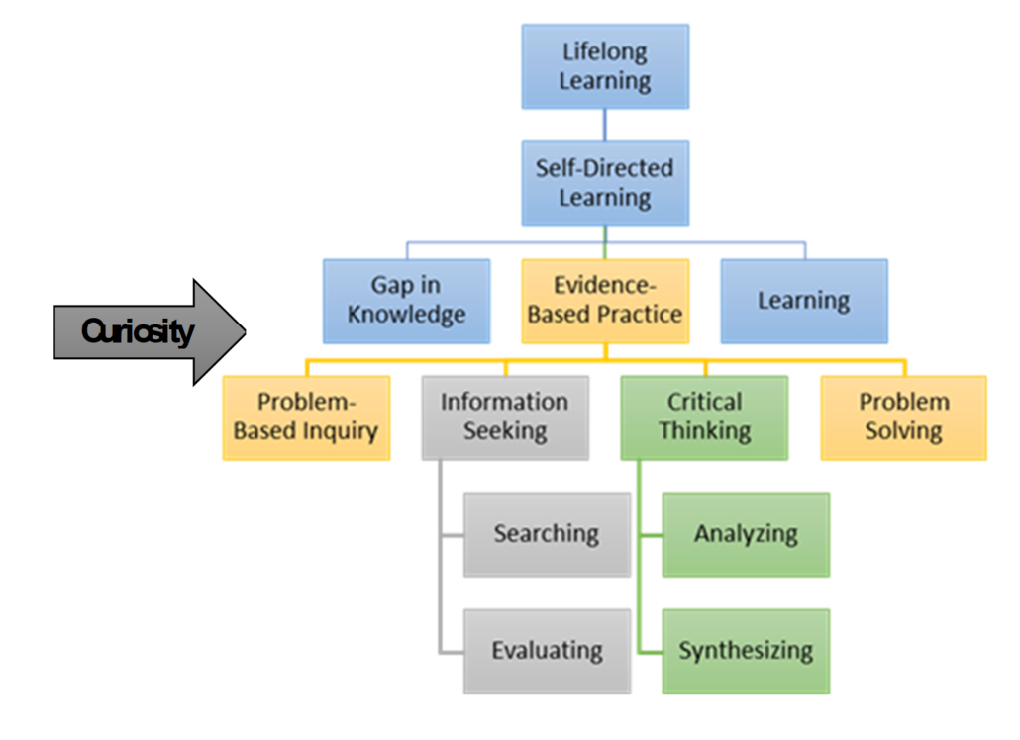
Measuring the Curiosity Continuum: Oregon Physician Assistant Perspectives on Curricular and Non-Curricular Contributors to Their Lifelong Learning, Critical Thinking, and Evidence-Based Practice
Credit: Sarah Drummond, Ed.D., OHSU Physician Assistant Program
Notes:
Conceptualization of relationships between elements of the curiosity continuum

